Slide 1


Financial Aid 2023-2024
1321 Butte St. Suite 101 Brad Williams
Redding, CA 96001 bwilliams@collegeoptions.org
530-244-4022 530-768-5103
@collegeoptionsinc on social media
WWW.COLLEGEOPTIONS.ORG
You can find this presentation under the Financial Aid tab on our website
It is labelled as 2023-2024 Financial Aid Presentation & Materials

Slide 2


Providing college and career preparation services
Serving students and families in the North State since 2003
A non-profit organization securing grant funding to be able to provide free services and resources to our 5-county region
  Modoc – Shasta – Siskiyou – Tehama - Trinity
Three primary service lines
  Academic/College Preparation
  Career Exploration
  Financial Aid
Appointments available 530-244-4022

Slide 3
Goals for Today
Take the mystery out of the financial aid process and provide a basic understanding of how financial aid works
Provide an understanding of how to maximize your financial aid potential
Help your family to be better informed consumers regarding education choices
Identify resources for help and assistance
Help you realize that there is a viable plan for each student

Slide 4
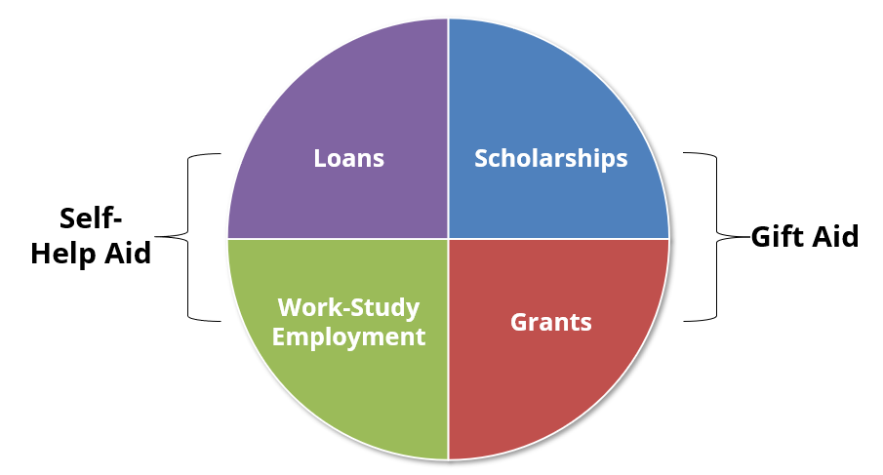
Types of Financial Aid

Slide 5
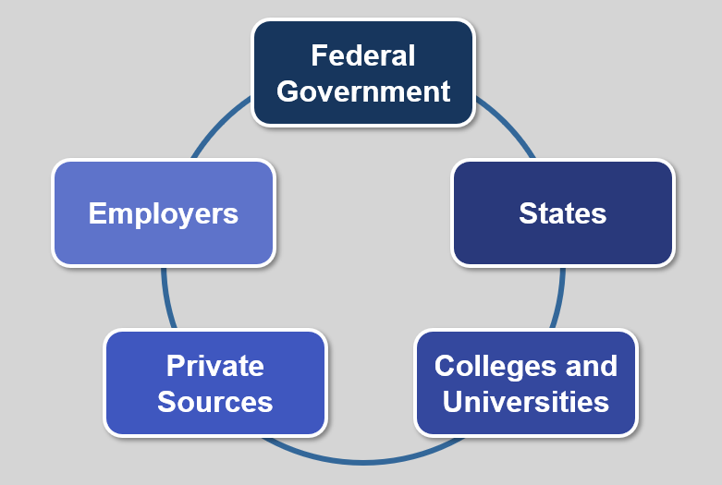
Sources of Financial Aid

Slide 6

What is the Free Application for Federal Student Aid?
Collects student and parent(s) income, assets and household information
Calculates the Expected Family Contribution (EFC)
Gateway to need-based student financial aid from:
  Federal Government
  State Government
  Colleges & Universities

Slide 7
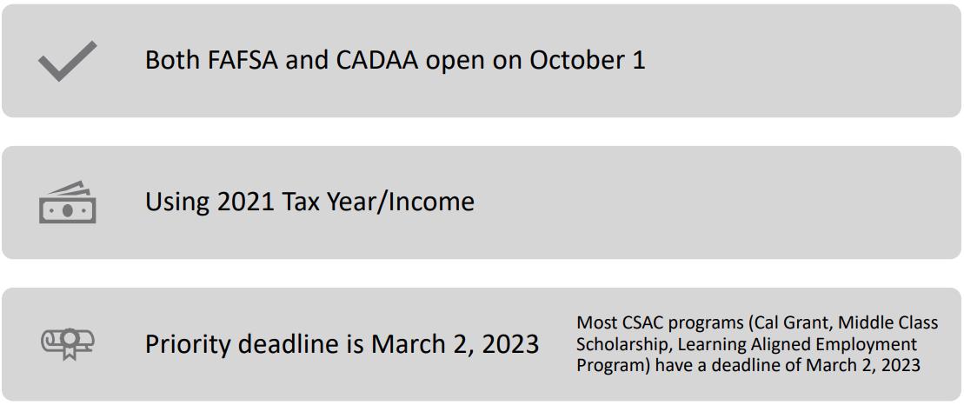
2023 – 2024 Important Information

Slide 8
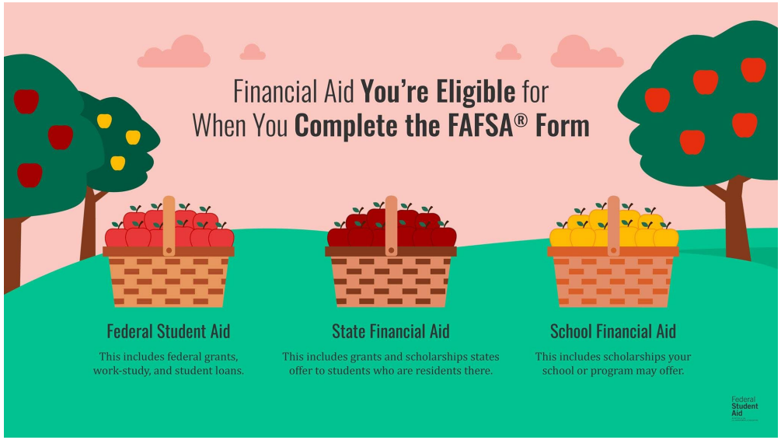
Multiple Agencies Receive FAFSA Data

Slide 9
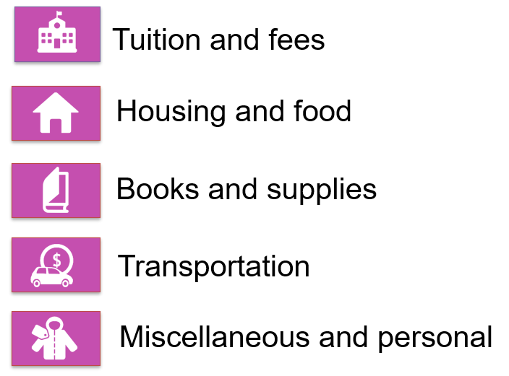
what is cost of attendance? (coa)

Slide 10
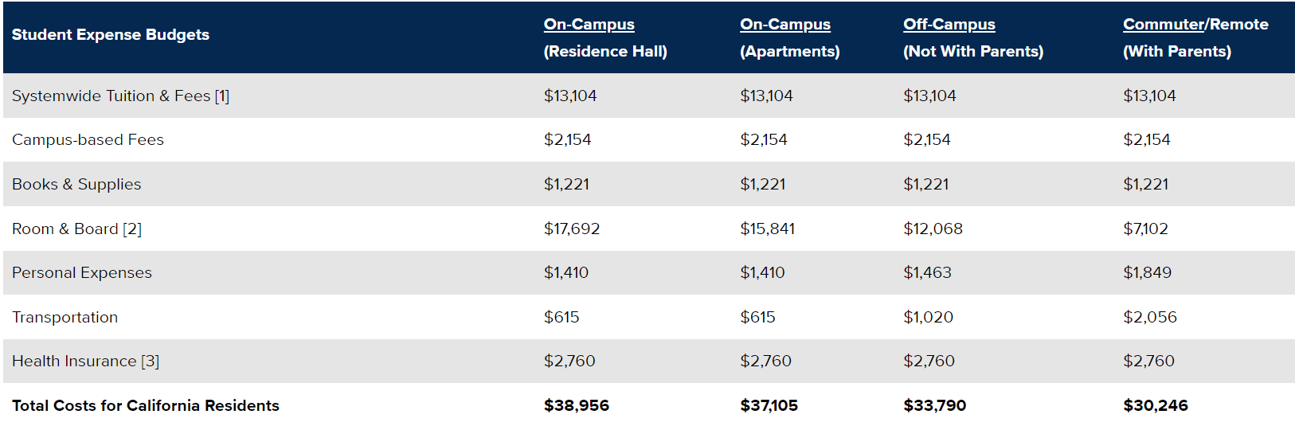
UC Davis Cost of Attendance 2022-2023 (ESTIMATED)

Slide 11

(ESTIMATED) Cost Of Attendance
Comparison 2022-2023
Shasta College (CA Community College)
  $13,424*
CSU Chico (CA Public 4-year)
  $26,728**
UC Davis (CA Public 4-year)
  $38,956**
University of the Pacific (Private)
  $72,374**
*Living with parent
**Living on Campus

Slide 12
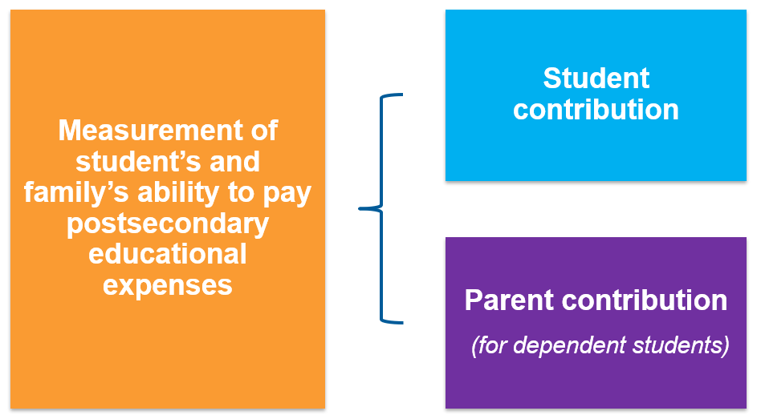
what is expected family contribution? (efc)

Slide 13

Financial Aid OFFErs
Applied to the school
+ accepted to the school
+ listed the school on your FAFSA
= You will get a Financial Aid Offer from the school
Example:
  COA $31,000 (Cost of Attendance)
  -EFC - $ 5,000 (Expected Family Contribution)
Financial Need $26,000
Schools offer varying amounts of financial aid, some more generous than others
Applying to multiple schools gives you more financial aid offers to consider

Slide 14
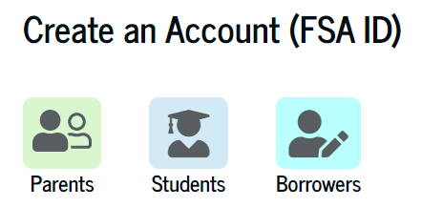
FSA ID Needed to File FAFSA
The FSA ID is a digital signature used to sign the FAFSA, Direct Loan and Parent PLUS loan Master Promissory notes, and to access federal student aid sites.
Student creates their own
Parent creates their own
  SSN and Date of Birth needed
Common mistakes:
  SSNs switched
  Parent creates password for student
  Student creates password for parent
Can log in with a verified mobile phone number
Federal Student Aid Help: (800) 4-FED-AID (800-433-3243)

Slide 15
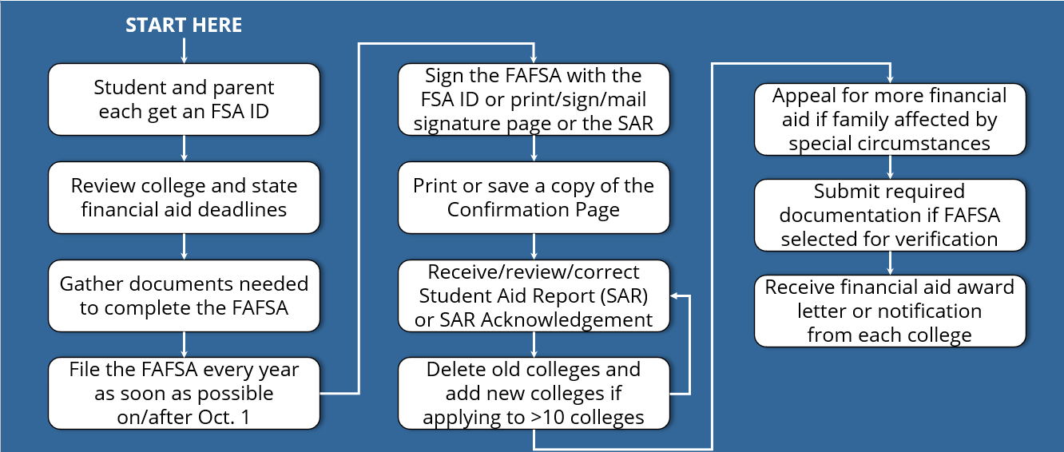
Summary of Financial Aid Process

Slide 16

When to File your FAFSA

Slide 17
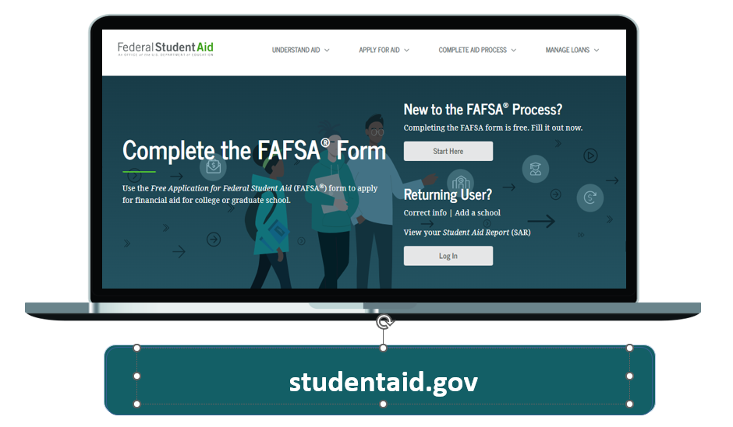
Where to File the FAFSA

Slide 18
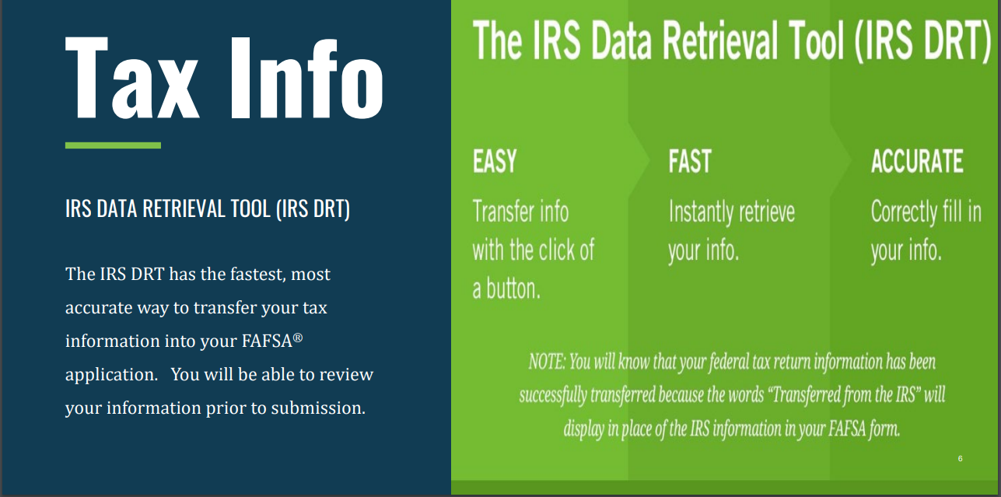
IRS DRT Speeds fafsa completion
FAFSA for 2023-2024 academic year requires 2021 tax return information

Slide 19

Why File A FAFSA???
FAFSA is your gateway to the 4 types of Financial Aid by way of 3 primary sources:
Federal Government
State Government
Higher Education Institutions
Takes about 30 minutes to complete the FAFSA
Get Expected Family Contribution (EFC) value immediately
Get Pell Grant (Federal) estimate immediately
Get Federal loan eligibility immediately
Find out if Cal Grant eligible soon after filing (from the California Student Aid Commission)
  Cal Grant Deadline: Must file the FAFSA by March 2nd

Slide 20

Compelling reasons to File A FAFSA
Even if you don’t think you will qualify for need based aid, consider the following:
Regardless of income level, a FAFSA must be filed to receive free CA Community College tuition
Allows for access to government student loans
Allows for the opportunity to secure need-based aid if life circumstances and/or financial circumstances change (special circumstances)
You can qualify for the CA Middle Class Scholarship even if you earned up to $217,000 of income and have up to $217,000 of assets
Some schools will not consider you for merit scholarships until you have submitted a FAFSA
FAFSA completion emphasized by CA unless steps are taken to opt-out

Slide 21
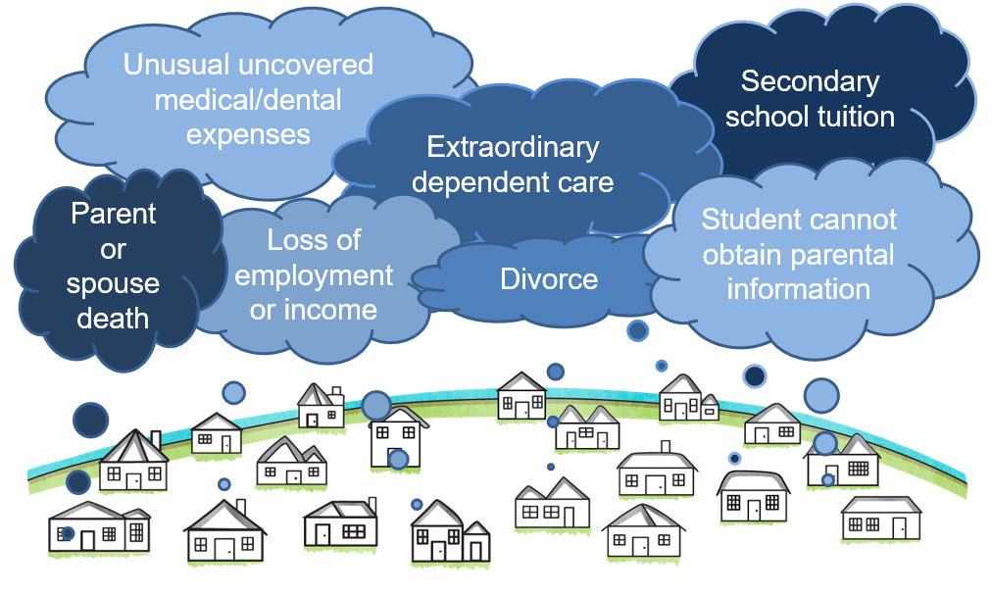
Special Circumstances

Slide 22
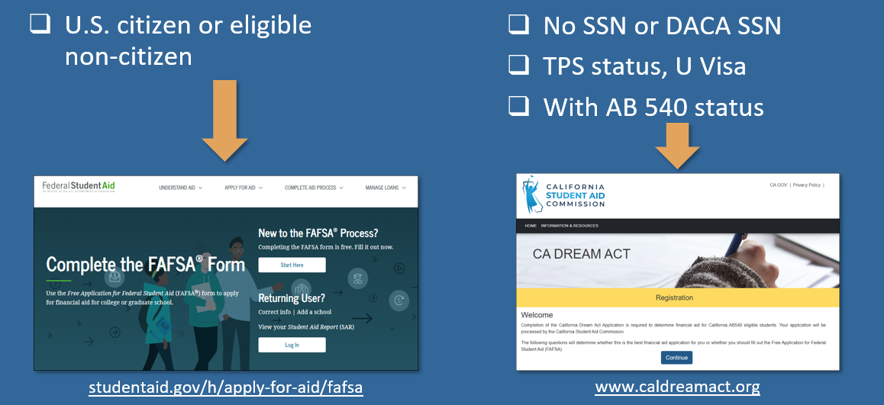
Which Financial Aid Application to Submit?

Slide 23


Financial AiD opportunities
Limited & Middle-Income families 2022-2023 Information
  Federal Aid*
    Pell Grant $692 - $6,895/year (6 years max)
      Maximum Pell Eligible EFC is 6206
    Work Study(college/university jobs)
    Federal Student Loans
  California Aid
    Cal Grant** $1,648 - $14,752/year (4 years max)
    California College Promise Program**
      First 2 years of community college tuition-free for first-time, full-time students who file a FAFSA
  Institutional Aid
    Scholarships: need-based and/or merit-based
      Varies by school
  *Applies to all accredited schools in US
  **Applies to all accredited and approved schools in California

Slide 24

Financial AiD opportunities
Higher Income families 2023-2024 Information
  Federal Aid*
    May be eligible for Federal Student Loans (cannot borrow past COA)
  California Aid
    California College Promise Program**
      First 2 years of community college tuition-free for first-time, full-time students who file a FAFSA
    California Middle Class Scholarship (MCS) - Up to $217,000 income and $217,000 assets
      Only CSU or UC schools are eligible for the MCS
      Award amounts vary - all costs in the Cost of Attendance calculation are eligible
      Could get an MCS award in addition to a Cal Grant
      Award notification usually in August
  Institutional Aid
    Merit-based scholarships
      Varies by school
  *Applies to all accredited schools in US
  **Applies to all accredited and approved schools in California
All families
  Western Undergraduate Exchange (WUE)
    Enables students in 16 western states & territories to enroll at 160+ participating public schools outside their home state and pay reduced tuition.
      WUE rate of 150% in-state tuition (or less)

Slide 25
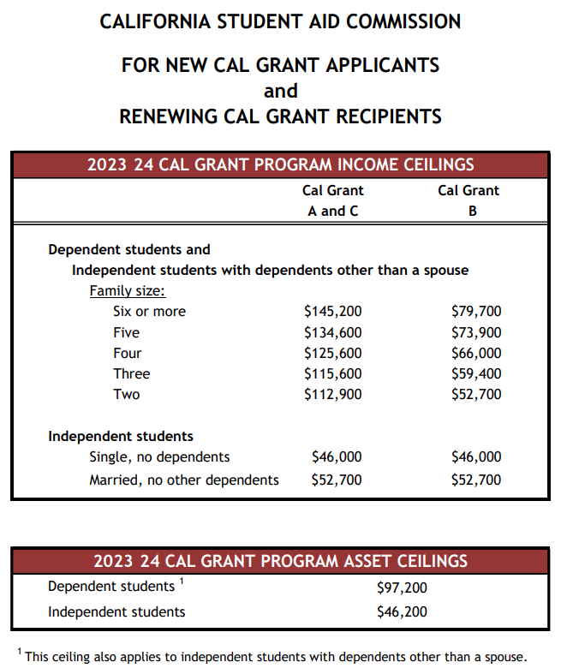

Cal Grant
Income &
Asset
Ceilings

Slide 26
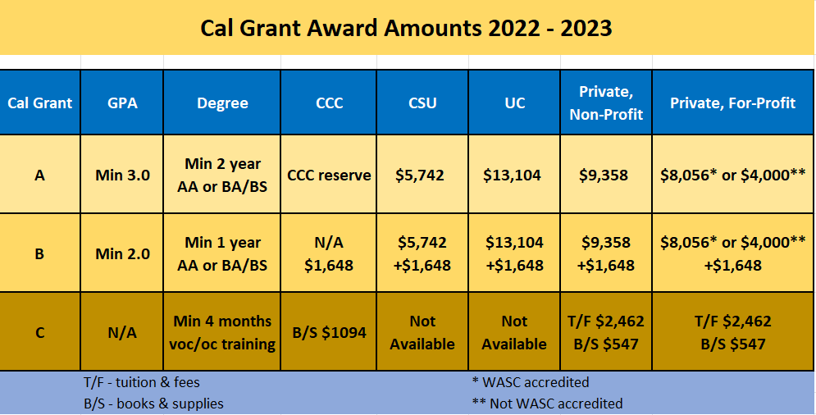

Slide 27
Ways to get a Cal Grant
High School Entitlement
  2 Year Window
    Senior Year of High School and 1 Year Later
CA Community College Entitlement
  Available even after the High School 2 year window
    Revises the FAFSA/CADAA filing deadline to September 2
  Continues when transferring to a UC or CSU campus if eligibility met
CA Community College Transfer Entitlement
  Available if meet eligibility criteria and are transferring to an eligible CA institution offering a baccalaureate degree
Competitive Awards
  “Last Chance Award”
    Very few offered, so very difficult to receive
Note that Cal Grant award values vary depending on whether A, B or C and the type of school attending
Notes:
Cal Poly San Luis Obispo requires ALL students who want to be considered for ANY scholarship from Cal Poly (whether based on need or not) to submit a financial aid application

Slide 28

EFC Calculation — Income
(For 2023-2024 School Year use 2021 Tax Return)
Parents
  When the student is considered “dependent” for FAFSA purposes
  If parents are divorced or separated, and not living together, use income from the parent that the student lived with more over the past twelve months
Student’s
  $7,600 is “protected” (for the 2023-2024 academic year)
  50% of income greater than $7,600 may be added to the EFC
Start with your Adjusted Gross Income (AGI) and include:
  Retirement Contributions in the tax year
  Untaxed Child Support
  Worker’s Compensation
  Housing Allowance
  Tax Exempt Interest
  Other Untaxed Income

Slide 29

EFC Calculation – Assets
Parents
  When the student is considered “dependent” for FAFSA purposes
    If parents are divorced or separated, and not living together, use assets from the parent that the student lived with more over the past 12 months
Student
  20% of student assets may be added into the EFC
    Assets are often best kept out of the name of the student
  Assets are calculated as of the day the FAFSA is filed

Slide 30

What Assets to declare for FAFSA
FAFSA Assets Do Not Include:
Home equity (in primary home)
Retirement accounts (IRA, 401k, 403b, Roth, etc.)
Life insurance & annuities
Assets entitled to a business or ranch/farm, if your family owns and controls more than 50% and have 100 or fewer full-time or FTE employees
Personal vehicles, boats, firearms, household goods, jewelry, tools etc.
Examples of FAFSA assets to declare:
Cash, Savings, Checking
Investment Real Estate
Stocks/Bonds/Trusts/Other Investments (not in retirement accounts)
College savings plans (reported as assets of the parents)

Slide 31
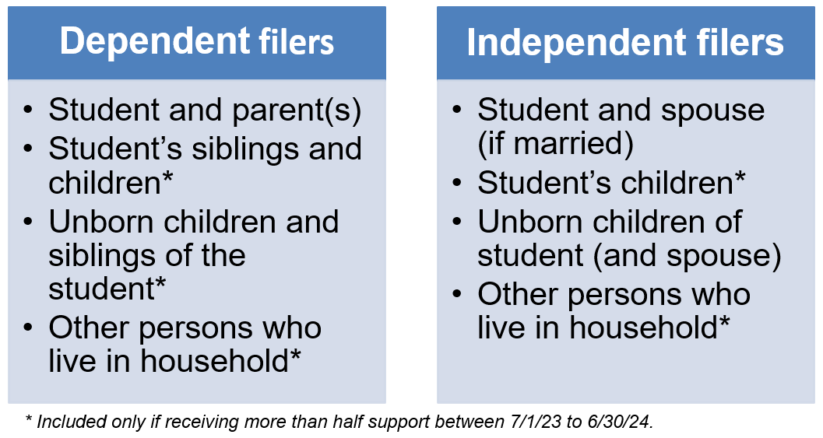
EFC Calculation – Number in Household

Slide 32

EFC Calculation – Number In the Household in College
(During the 2023-2024 School Year)
You (the student)
Siblings living in/supported by the same household (if they meet FAFSA definition of dependent)
If parent is also a college student, s/he is NOT included on student’s FAFSA (but is included on parent’s FAFSA)

Slide 33
Didn’t GET enough financial aid? Consider these options
  Negotiate: Ask the college or university for more financial aid
  Scholarships: More detail on future slide
  Special Circumstances Consideration: More detail on future slide
  Student job: Work study or on-campus or off-campus
  Payment Plans: Your school may have plans to avoid lump sum payments, allowing for several payments throughout a semester
  Parent Savings: Food, gas, insurance savings while student is in college
  Family resources: Savings, sell assets, 2nd mortgage, credit cards, etc.
  Current Income: Allocate more to education expenses
  Additional Loans: Government PLUS loans or private loans

Slide 34

Reducing College Costs
Career Planning before/during college
  Changing your major (or college) costs time and money!
  Internet research, informational interviews, job shadowing
  Avoid dropping classes and focus on graduating on time
Graduate on Time
  The longer you are in school, the more it will cost you
Apply for scholarships
  Priority on local (smaller applicant pool)
  If you are eligible, apply!
Buy used textbooks or rent them
Borrow responsibly
Use College OPTIONS tools
  to evaluate and compare award offers
  project costs over time
  make decisions based on objective factors
Consider an alternative college
  Community Colleges can be great options

Slide 35

What About Scholarships?
Your High School
  Counselors know about scholarships given previously to their students
The McConnell Foundation & The Ford Family Foundation (Siskiyou)
  McConnell Scholars Program & Ford Scholars Program
Community Foundation of the North State
  Approximately 30 scholarship opportunities
Reach Higher Shasta
  Scholarship Database
    Over 60 entries
Local Chambers of Commerce, Rotary Clubs, Civic Groups, etc.
Paying for College: Student Resource Guide
  Student Resources portion of website of Congresswoman Lucille Royal-Allard
    Serving California’s 40th Congressional District
National Scholarships (lots out there/lots of competition)
  Thousands of scholarships identified by each search engine (3 examples)
    Sallie Mae
    Fastweb
    Big Future
Your College/University Admissions and/or Financial Aid Office

Slide 36
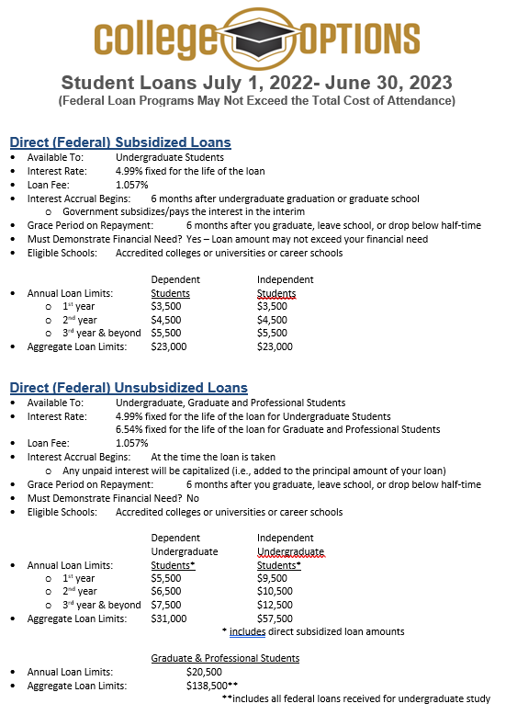


Slide 37
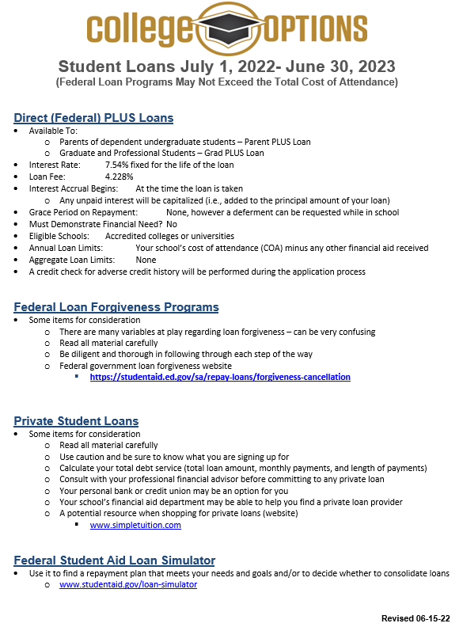


Slide 38
Spend your Education Dollar Wisely
Retention rate is the percentage of a school’s first-time, first-year undergraduate students who continue at that school the next year. For example, a student who studies full-time in the fall semester and keeps on studying in the program in the next fall semester is counted in this rate.
Graduation rate is the percentage of a school’s first-time, first-year undergraduate students who complete their program.
College Retention Rate 4-year Graduation Rate 6-year Graduation Rate
CSU Chico 81% 33% 65%
CSU Sacramento 81% 20% 57%
Southern Oregon University 69% 28% 41%
Stanford University 98% 77% 96%
UC Davis 91% 62% 87%
University of Nevada, Reno 78% 40% 63%
University of Oregon 87% 61% 74%
University of the Pacific 84% 44% 66%
College Comparisons- https://nces.ed.gov/collegenavigator/

Slide 39

College OPTIONS Financial Aid Tools and Resources

Slide 40
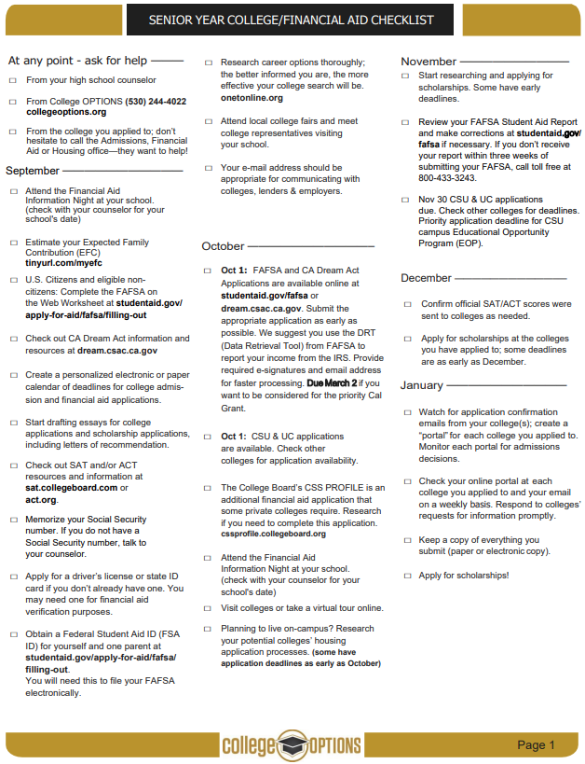


Slide 41
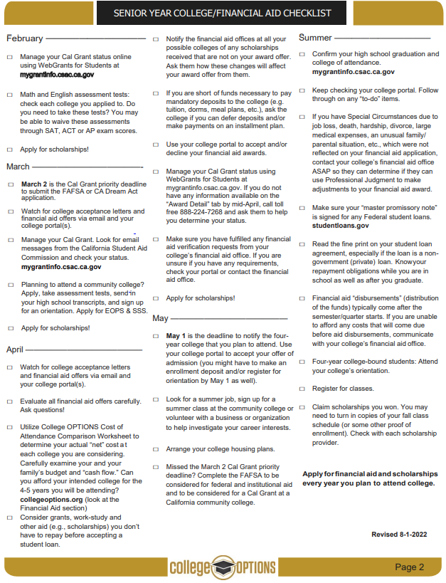


Slide 42

College OPTIONS Financial Aid Services
College OPTIONS is a local educational partnership that provides services at no cost to students of all ages who live in Modoc, Shasta, Siskiyou, Tehama or Trinity counties. Financial Aid services are specifically designed to meet individual needs.
College OPTIONS does not guarantee any specific grants, scholarships, loans or government funding.
Students who receive services, and their parents or other responsible adults, are expected to provide accurate and complete information to advisors for all applications for financial aid. The best options for financial aid are based on up-to-date information.
Our advisors are not financial professionals. We urge students and families to verify information and weigh the options before making financial decisions.
It is our policy to maintain the privacy of every student who accesses services through College OPTIONS. We do not share information with any outside agencies, companies or individuals. With the student’s permission, we may discuss a student’s progress with other educators and/or college admissions and/or financial aid officers for the benefit of the student.
We welcome suggestions, comments and feedback of any kind. The best services are the result of diligent efforts by everyone.
Thank you for allowing us to be of assistance to you.

Slide 43

Some Considerations and Reminders
Cal Grant is good for 4 academic years, including Community College
  Use it wisely
Meet all deadlines - Cal Grant has a March 2 FAFSA filing deadline (except for community college attendance, which is September 2)
Consider applying to multiple schools to see multiple financial aid offers
“Verification” is a financial aid process conducted by your college/university financial aid office
  No need to be fearful of this - prove to us that your FAFSA information is true
    Keep bank statements from your FAFSA filing date
Department of Education College Scorecard
  Compare schools – cost, graduation rate, employment rate, average amount borrowed, loan default rate
  www.collegescorecard.ed.gov
Reach out to College OPTIONS if you need assistance
  www.collegeoptions.org
  530-244-4022
Follow College OPTIONS on social media @collegeoptionsinc

Slide 44



WITH GRATITUDE!!!
A huge thank you to these
College OPTIONS funders!!!
Because of their generosity, all services provided by College OPTIONS personnel are free to North State families

Slide 45


Thank you!!!
We are always trying to improve our effectiveness.
  If you have suggestions for improvement, please see me or call me or email me
  Brad Williams
  Director of Financial Aid Services
  College OPTIONS
  Email: bwilliams@collegeoptions.org
  Phone: 530-768-5103
Thank you for attending this presentation and for your interest in financial aid

