Slide 1


Financial Aid 2024-2025
1321 Butte St. Suite 101 Brad Williams
Redding, CA 96001 bwilliams@collegeandcareeroptions.org
530-244-4022 530-768-5103
@collegeandcareeroptions on social media
WWW.COLLEGEANDCAREEROPTIONS.ORG

Slide 2



Providing college and career preparation services
Serving students and families in the North State since 2003
A non-profit organization securing grant funding to be able to provide free services and resources to our 5-county region
  Modoc – Shasta – Siskiyou – Tehama - Trinity
Three primary service lines
  Academic/College Preparation
  Career Exploration
  Financial Aid
Appointments available 530-244-4022

Slide 3

Goals for Today
Take the mystery out of the financial aid process and provide a basic understanding of how financial aid works
Provide an understanding of how to maximize your financial aid potential
Identify resources for help and assistance

Slide 4
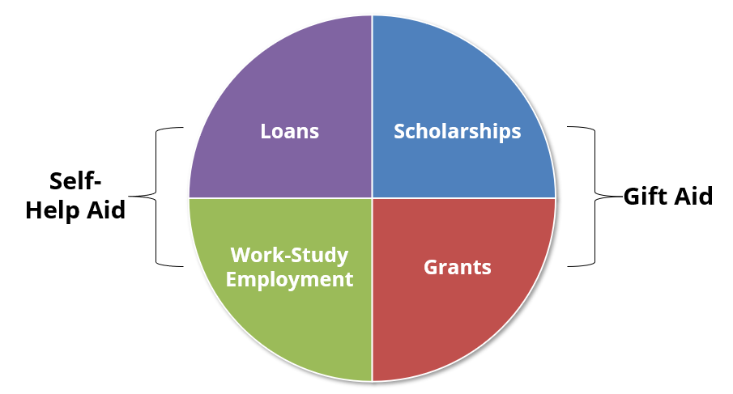
Types of Financial Aid

Slide 5
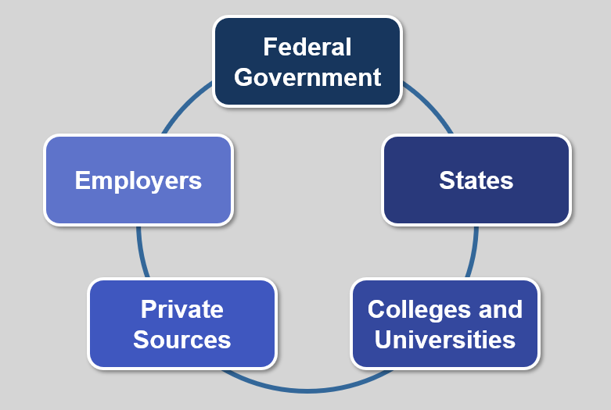
Sources of Financial Aid

Slide 6

What is the Free Application for Federal Student Aid?
Collects student and parent(s) income, assets and household information
Calculates the Student Aid Index (SAI), a measure of the family’s financial strength
Gateway to need-based student financial aid from:
  Federal Government
  State Government
  Colleges & Universities

Slide 7
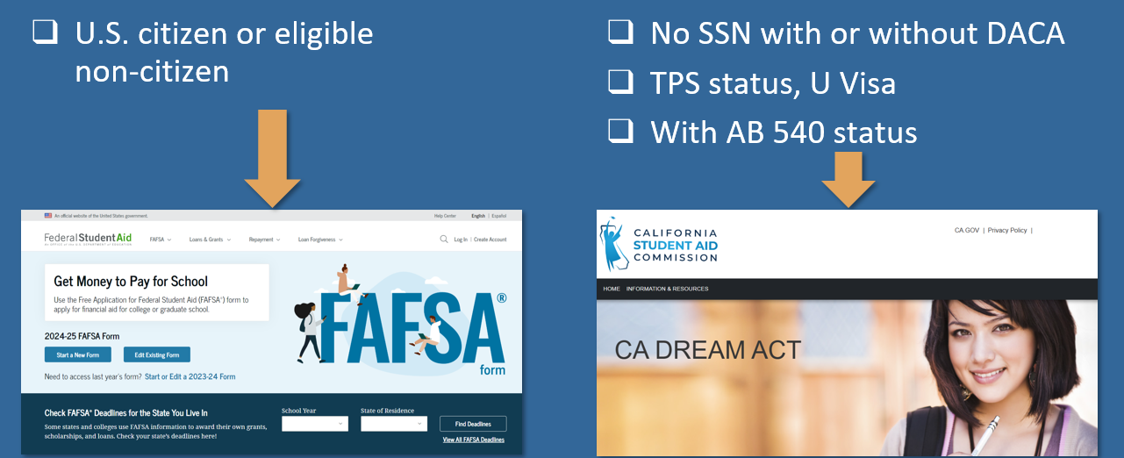
Which Financial Aid Application to Submit?

Slide 8

Compelling reasons to File A FAFSA
Even if you don’t think you will qualify for need based aid, consider the following:
Regardless of income level, a FAFSA must be filed to receive free CA Community College tuition
Allows for access to government student loans
Allows for the opportunity to secure need-based aid if life circumstances and/or financial circumstances change (special circumstances)
You can qualify for the CA Middle Class Scholarship even if you earned up to $226,000 of income and have up to $226,000 of assets
Some schools will not consider you for merit scholarships until you have submitted a FAFSA
FAFSA completion required for CA high school seniors unless opt-out

Slide 9


Special Circumstances
Student or contributor experiences significant changes to their financial situation:
  Loss of employment or financial assets
  Reduction in income
  Tuition expenses at an elementary or secondary school
  Unusual medical or dental expenses not covered by insurance
  More than 1 child in college at the same time
    No more “sibling discount” in the SAI formula

Slide 10
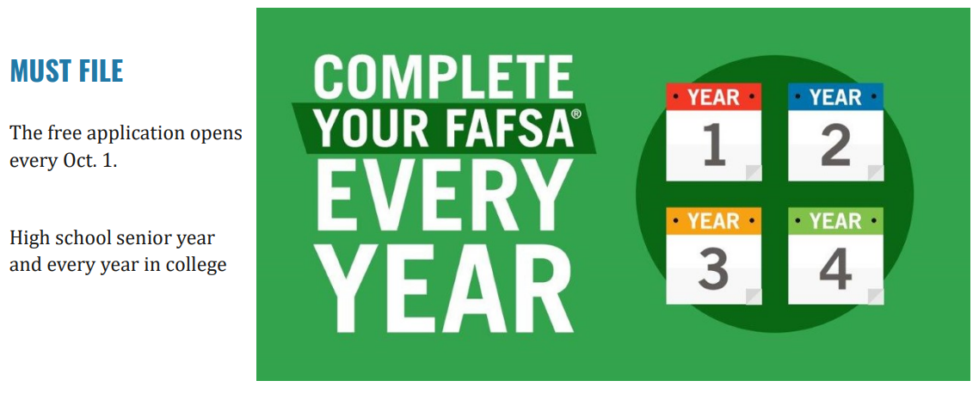
WHEN TO FILE THE FAFSA?

Slide 11
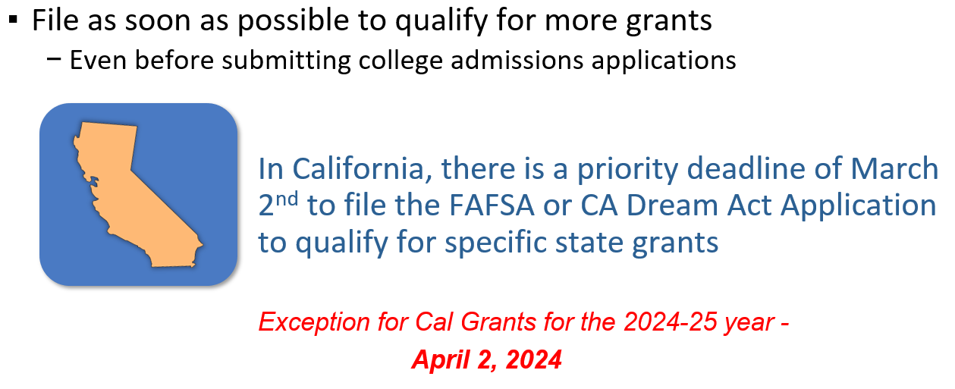
WHEN TO FILE THE FAFSA? (continued)

Slide 12
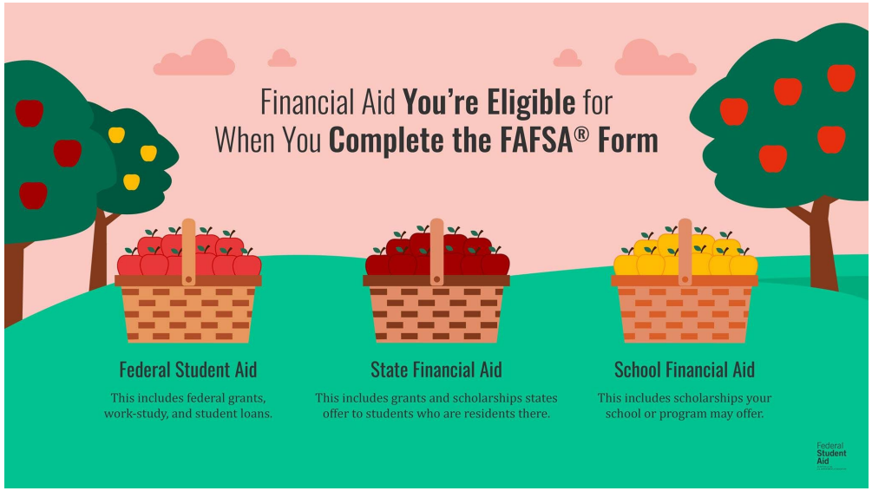
Multiple Agencies Get FAFSA Data Simultaneously

Slide 13
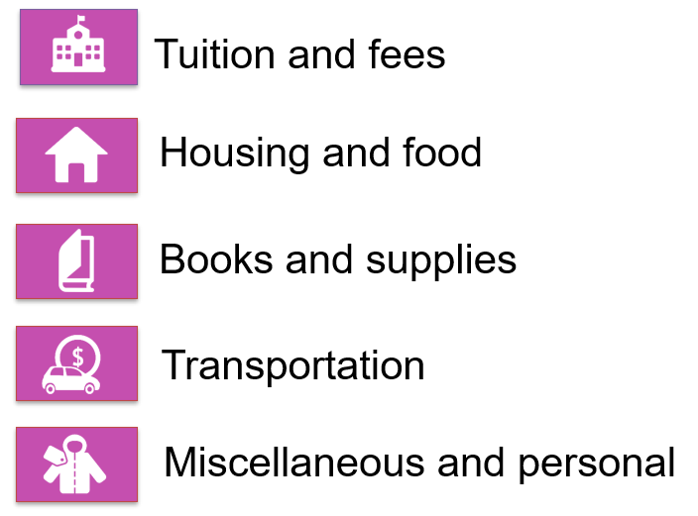
what is cost of attendance? (coa)

Slide 14
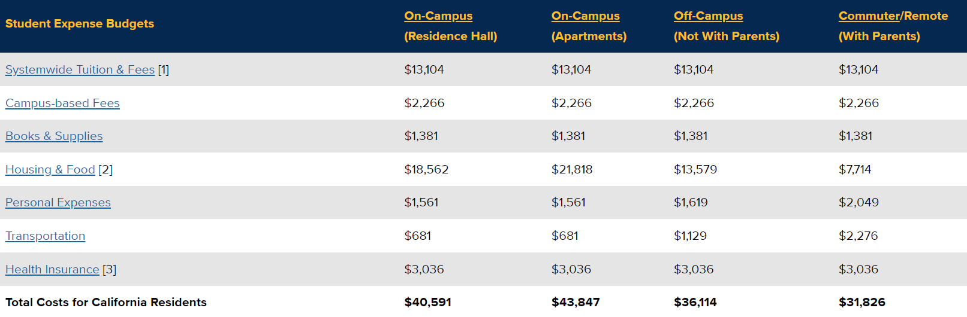
UC Davis Cost of Attendance 2023-2024 (ESTIMATED)

Slide 15

(ESTIMATED) Cost Of Attendance
Comparison 2023-2024
Shasta College (CA Community College)
  $14,422*
CSU Chico (CA Public 4-year)
  $28,030**
UC Davis (CA Public 4-year)
  $40,591**
University of the Pacific (Private)
  $75,573**
*Living at Home
**Living on Campus

Slide 16
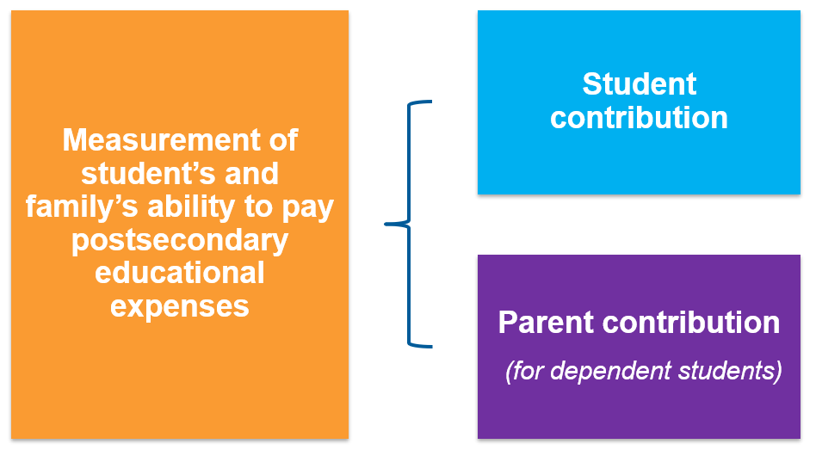
what is the student aid index? (sai)

Slide 17

Financial Aid OFFErs
Applied to the school
+ accepted to the school
+ listed the school on your FAFSA (can list up to 20)
= You will get a Financial Aid Offer from the school
Example:
  COA $31,000 (School Cost of Attendance)
  -SAI - $ 5,000 (Your Student Aid Index)
Financial Need $26,000
Schools offer varying amounts of financial aid, some more generous than others
Applying to multiple schools gives you more financial aid offers to consider

Slide 18
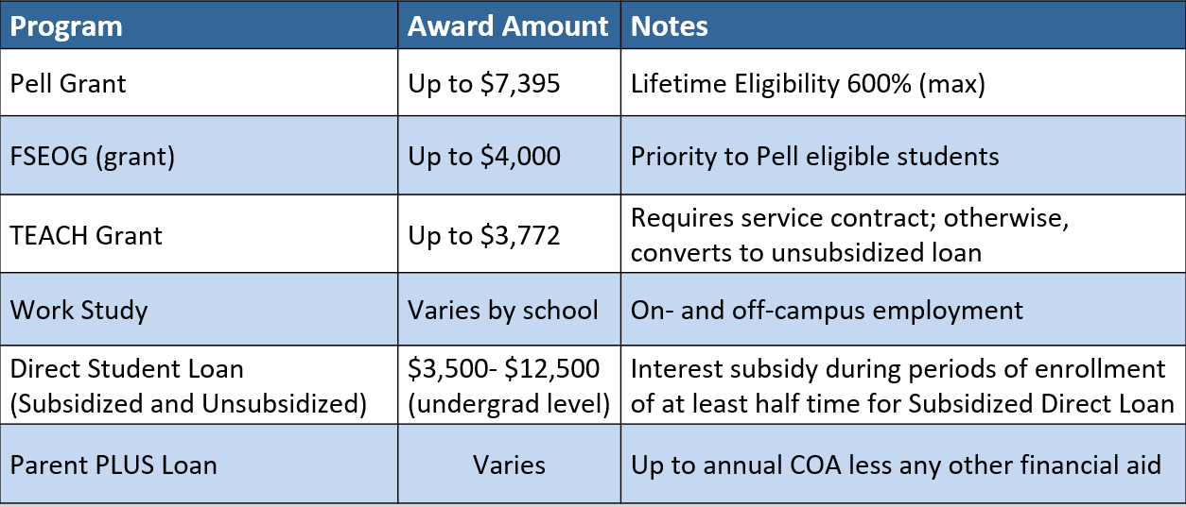
Financial AiD opportunities
Federal Aid Programs - 2023-2024 Information

Slide 19
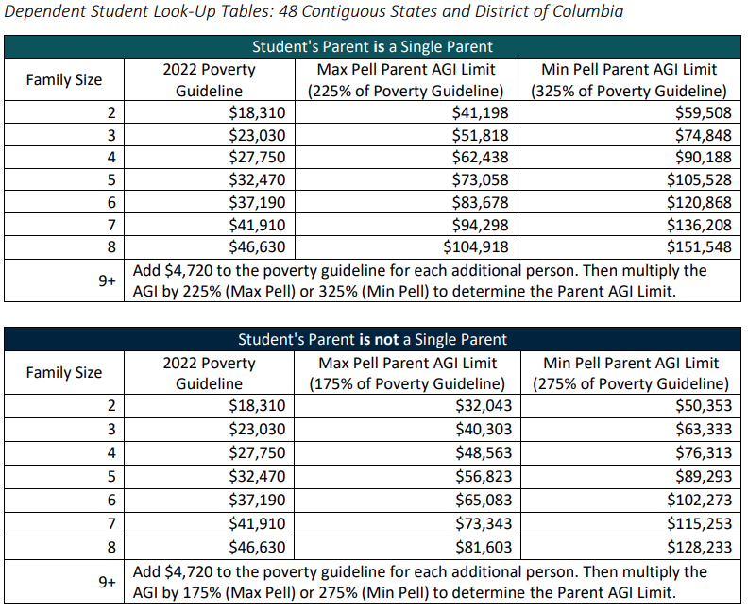
Financial AiD opportunities
Federal Pell Grant Program Aid Program - 2024-2025 Information

Slide 20

Financial AiD opportunities
Federal Aid Programs - 2023-2024 Information
  How is a Pell Grant Award determined?
    An automatic Maximum Pell Grant Award of $7,395 per year – Max Pell
    (see eligibility chart)
    SAI-calculated Pell Grant
      Maximum Pell Grant (i.e., $7,395) – SAI = Pell Award
    A Minimum Pell Grant Award of $740 – Min Pell (i.e., 10% of Max Pell)
    (see eligibility chart) – Min Pell
  Federal Student Aid Estimator
    studentaid.gov/aid-estimator
  Taming the High Cost of College SAI Calculator
    tamingthehighcostofcollege.com/student-aid-index-sai-efc-calculator/
  Both sites calculate Student Aid Index (SAI) and give federal financial aid estimate (Pell Grant)

Slide 21


Financial AiD opportunities
California Aid Programs* - 2023-2024 Information
  Cal Grant $1,648 - $15,400/year (4 years max)
  California College Promise Program
    First 2 years of community college tuition-free for lower income students who file a FAFSA/CADAA
  Shasta Promise – Shasta College
    Full-time student + file a FAFSA/CADAA = free tuition (regardless of income)
  California Middle Class Scholarship (MCS) - Up to $226,000 income and $226,000 assets
  *Applies to all accredited and approved schools in California

Slide 22
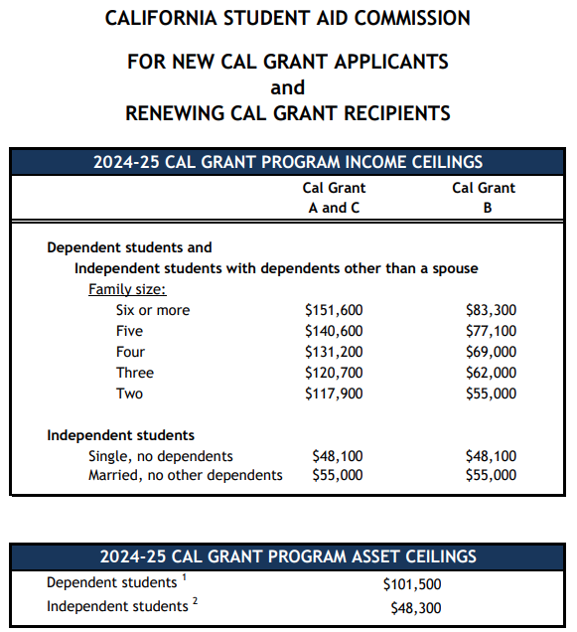

Cal Grant
Income &
Asset
Ceilings
CA is working on implementing Cal Grant reform beginning with the 2024-2025 academic year. If reform takes place, the income and asset ceilings will change. A decision is expected in May 2024.

Slide 23
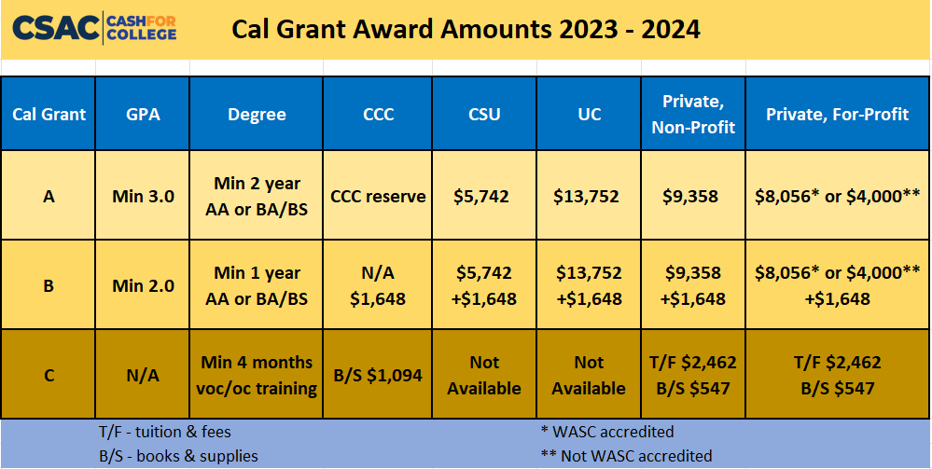

Slide 24

California middle class scholarship
  Students enrolled at a UC or CSU whose income exceeds limits for Cal Grant will automatically be considered for the California Middle Class Scholarship
    If the student’s FAFSA or CADAA is submitted by March 2 (April 2 for 2024 only)
  Students with family income and assets up to $226,000 may be eligible
  Award determination is based on a complicated formula
  This is a last dollar award, so all other grants, scholarships, fee waivers will be applied first

Slide 25
Financial AiD opportunities
Institutional Aid
  Scholarships & Grants
    Need-based (financial need) and/or
    Merit-based (student talent or skill)
    Scholarships & Grants vary by school
      Apply to several schools to see several financial aid offers
Out of State Schools
  Western Undergraduate Exchange (WUE)
    Enables students in 16 western states & territories to enroll at 160+ participating public schools outside their home state and pay reduced tuition.
      WUE rate of 150% in-state tuition (or less)

Slide 26
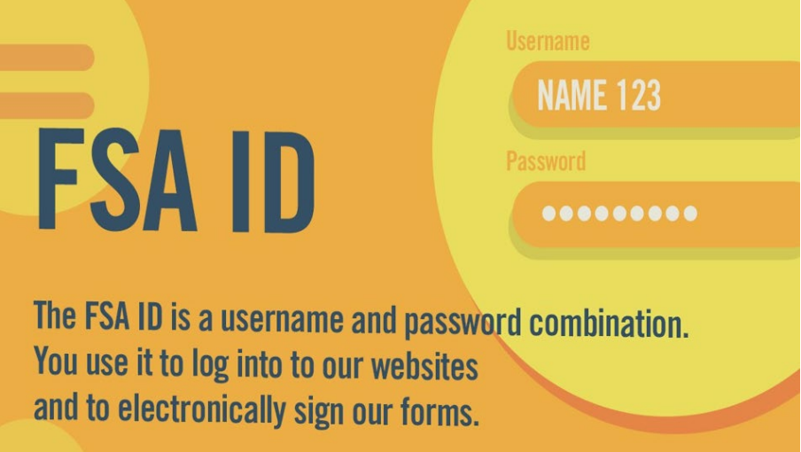
FSA ID Needed to File FAFSA
Create Federal Student Aid (FSA) ID and Password at studentaid.gov
  Every contributor will need an FSA ID to access the FAFSA
  Important Note: The student and 1 parent (maybe both parents) need to create an individual account to access the FAFSA
  Student and Parent cannot use the same username and password
  Individuals without a Social Security number can create an FSA ID
  Federal Student Aid Help
(800) 4-FED-AID
(800-433-3243)

Slide 27
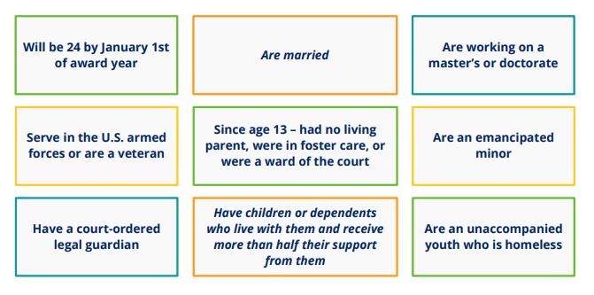
A student is considered to be Independent if any one of these apply:
Otherwise, they are considered to be Dependent

Slide 28
Unusual circumstances
A dependent student may indicate that they are unable to provide parent information due to “unusual circumstances”
This will allow them to submit the FAFSA under a provisional Independent status
A financial aid administrator at your school will determine whether the student is eligible for a dependency override (i.e., keeping the Independent status)
Examples: parental abandonment or estrangement, death of a parent, student or parent incarceration, human trafficking, refugee or asylum status, unable to contact parents, contact with parents poses risks

Slide 29
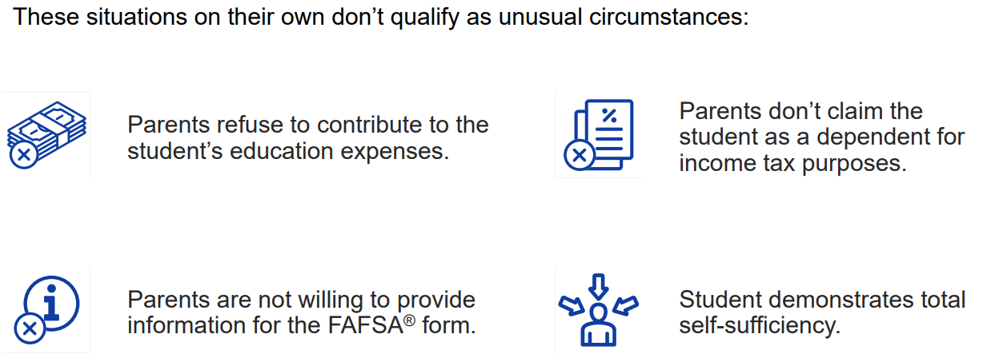
What is not considered an Unusual circumstance?

Slide 30

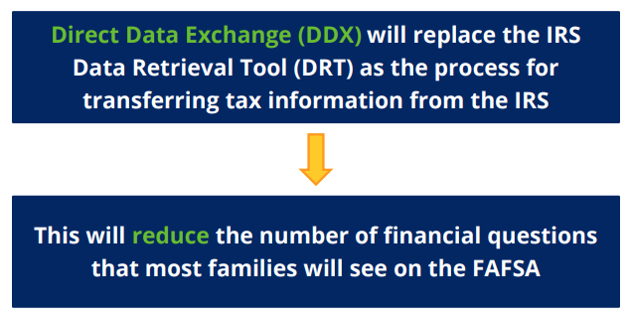
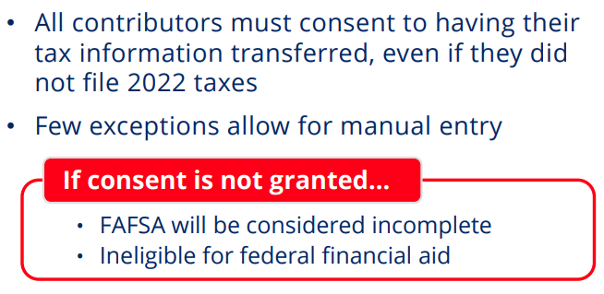
Federal tax information
FAFSA for 2024-2025 academic year requires 2022 tax return information

Slide 31
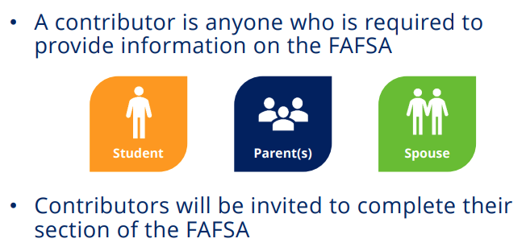
Contributors

Slide 32



Which Parent(s) Is A/Are FAFSA Contributor(s)?
Consider parents (biological or adoptive) marital status as of the the day the FAFSA is filed
Unmarried, Divorced, or Separated Parents & not living together
  Primary Parent for FAFSA filing purposes = The parent that provided the most financial support to the student in the last 12 months
    Report only the primary parent’s information unless they have remarried, then report both the primary parent and the stepparent’s information
Unmarried, Divorced, or Separated Parents & living together
  Report both parent’s information
Parents are Married and not separated
  Report both parent’s information

Slide 33
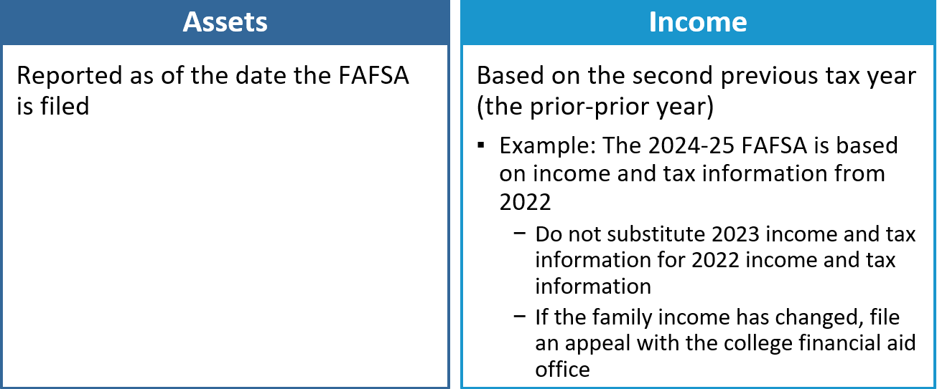
Which year’s information is reported?

Slide 34

Sai calculation - Income
(For 2024-2025 School Year use 2022 Tax Return information)
Parent’s
  When the student is considered “dependent” for FAFSA purposes
Student’s
  $11,130 is “protected” (for the 2024-2025 academic year)
  50% of income greater than $11,130 may be added to the SAI
Start with your Adjusted Gross Income (AGI) and include:
  IRA Deductions/Payments to self-employed SEP, SIMPLE & Qualified Retirement Plans
  Tax Exempt Interest Income
  Untaxed Portions of Pensions (excluding rollovers)
  Untaxed Portions of IRA Distributions (excluding rollovers)
  Foreign Income Exclusion (reported on U.S. Tax Return)

Slide 35

Exempt from asset reporting
Dependent student meets one of these criteria:
  The student qualifies for a Maximum Pell Grant
  The student’s parents’ 2022 combined AGI is less than $60,000 and
    They do not file a Schedule A, B, D, E, F, or H, and
    They do not file a Schedule C, or
      They file a Schedule C with net business income of not more than a $10,000 loss or gain
  Receiving any 1(or more) of 9 federal benefits in 2022 or 2023
    9 named programs including:
      “Free or reduced-price school lunch”
        A universal program in all CA TK-12 public schools
          Check the federal income guidelines for FAFSA eligibility (next slide)

Slide 36
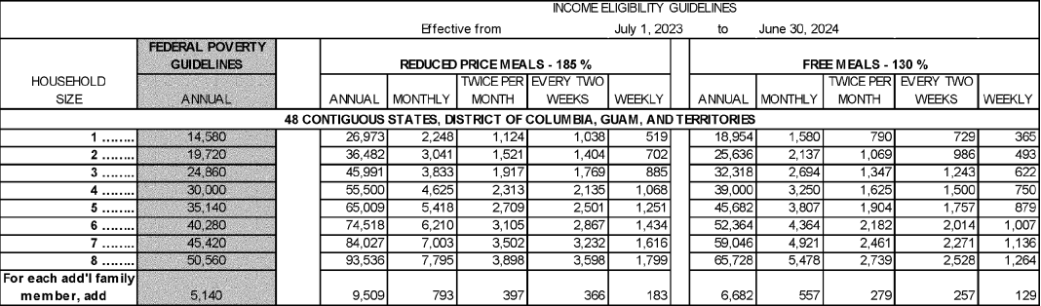
Free or reduced-price school lunch

Slide 37
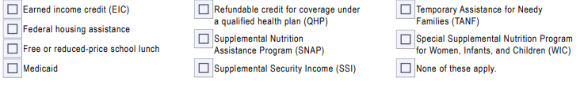

Fafsa definition of federal benefits received
At any time during 2022 or 2023, did the parent or anyone in their family receive benefits from any of the following federal programs?
EIC can be found on line 27 of your 2022 1040 tax return
Medi-Cal is the CA version of Medicaid
CalFresh is the CA version of SNAP
SSDI is not the same benefit as SSI
CalWORKs is the CA version of TANF

Slide 38

What Assets to declare for FAFSA
FAFSA Assets Do Not Include:
Home equity (in primary home)
Retirement accounts (IRA, 401k, 403b, Roth, etc.)
Life insurance & annuities
Personal vehicles, boats, firearms, household goods, jewelry, tools etc.
Examples of FAFSA assets to declare:
Cash, Savings, Checking
Net worth of land, investment real estate, etc.
Stocks/Bonds/Trusts/Other Investments (not in retirement accounts)
Net worth of businesses and/or for-profit agricultural operations
College savings plans/529 plans – do not include the value of siblings’ plans (reported as assets of the parents)
Child support received in the last complete calendar year
Note: if net worth is negative, enter zero

Slide 39

sai Calculation – Assets
Parent
  When the student is considered “dependent” for FAFSA purposes
Student
  20% of student assets may be added into the SAI
    Assets are often best kept out of the name of the student
  Assets are calculated as of the day the FAFSA is filed

Slide 40

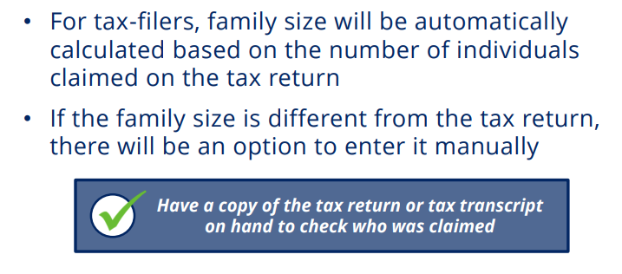
SAI Calculation - Family size

Slide 41
Fafsa definition of Family size
How many people are in the parent’s family?
  Include
    the parent (and spouse or partner)
    the student
    the parent’s dependent children (even if they live apart because of college enrollment)
    and other people living with the parent now
Include these dependent children and other people only if the parent will provide more than half of their support between July 1, 2024, and June 30, 2025

Slide 42

Didn’t GET enough financial aid? Consider these options
  Negotiate: Ask the college or university for more financial aid
  Scholarships: More detail on future slide
  Special Circumstances Consideration: More detail on prior slide
  Student job: Work study or on-campus or off-campus
  Payment Plans: Your school may have plans to avoid lump sum payments, allowing for several payments throughout a semester
  Parent Savings: Food, gas, insurance savings while student is in college
  Family resources: Savings, sell assets, 2nd mortgage, credit cards, etc.
  Current Income: Allocate more to education expenses
  Additional Loans: Government PLUS loans or private loans

Slide 43

Reducing College Costs
Career Planning before/during college
  Changing your major (or college) costs time and money!
  Internet research, informational interviews, job shadowing
  Avoid dropping classes and focus on graduating on time
Graduate on Time
  The longer you are in school, the more it will cost you
Apply for scholarships
  Priority on local (smaller applicant pool)
  If you are eligible, apply!
Buy used textbooks or rent them
Borrow responsibly
Use College & Career OPTIONS tools
  to evaluate and compare award offers
  project costs over time
  make decisions based on objective factors
Consider an alternative college
  Community Colleges can be great options

Slide 44

What About Scholarships?
Your High School
  Counselors know about scholarships given previously to their students
The McConnell Foundation – McConnell Scholars Program
The Ford Family Foundation – Ford Scholars Program
  Siskiyou County high school students
Community Foundation of the North State
  Approximately 30 scholarship opportunities
Reach Higher Shasta
  Scholarship Database
    Over 60 entries
Local Chambers of Commerce, Rotary Clubs, Civic Groups, etc.
National Scholarships (lots out there/lots of competition)
  Thousands of scholarships identified by each search engine (3 examples)
    Sallie Mae
    Fastweb
    Big Future
Your College/University Admissions and/or Financial Aid Office

Slide 45
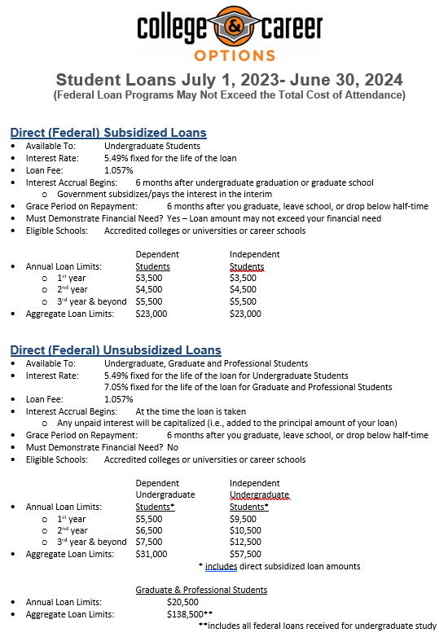


Slide 46
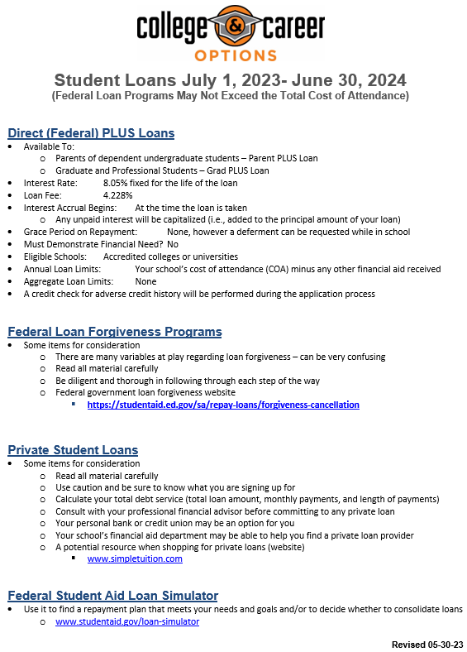


Slide 47

College & Career OPTIONS Financial Aid Tools and Resources

Slide 48
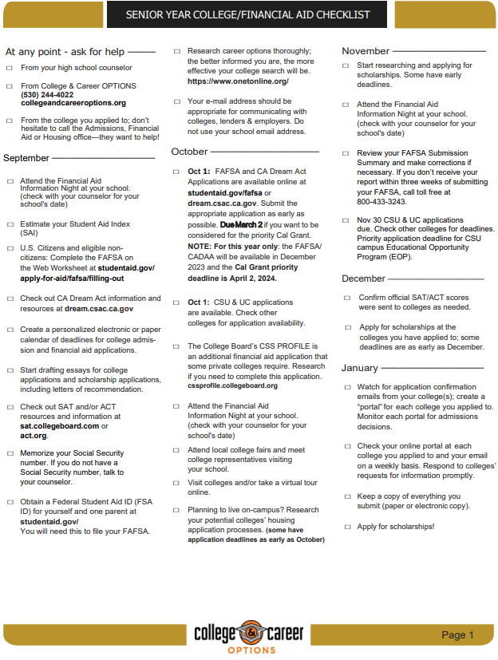



Slide 49
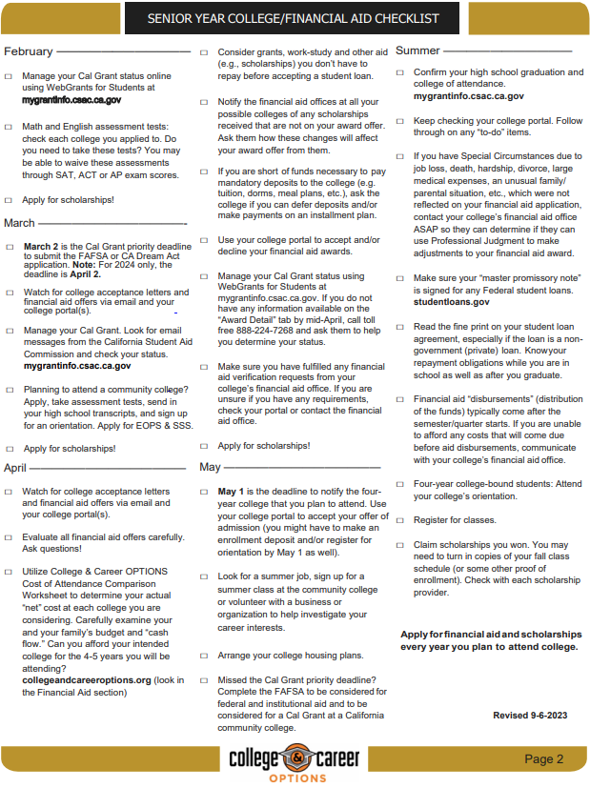


Slide 50

College & career OPTIONS Financial Aid Services
College & Career OPTIONS is a local educational partnership that provides services at no cost to students of all ages who live in Modoc, Shasta, Siskiyou, Tehama or Trinity counties. Financial Aid services are specifically designed to meet individual needs.
College & Career OPTIONS does not guarantee any specific grants, scholarships, loans or government funding.
Students who receive services, and their parents or other responsible adults, are expected to provide accurate and complete information to advisors for all applications for financial aid. The best options for financial aid are based on up-to-date information.
Our advisors are not financial professionals. We urge students and families to verify information and weigh the options before making financial decisions.
It is our policy to maintain the privacy of every student who accesses services through College & Career OPTIONS. We do not share information with any outside agencies, companies or individuals. With the student’s permission, we may discuss a student’s progress with other educators and/or college admissions and/or financial aid officers for the benefit of the student.
We welcome suggestions, comments and feedback of any kind. The best services are the result of diligent efforts by everyone.
Thank you for allowing us to be of assistance to you.

Slide 51

Some Considerations & Reminders
Cal Grant is good for 4 academic years, including Community College
  Use it wisely
Meet all deadlines - Cal Grant has a March 2 (April 2 in 2024 only) filing deadline (except for California community college attendance, which is September 2)
Consider applying to multiple schools to see multiple financial aid offers
“Verification” is a financial aid process conducted by your college/university financial aid office
  No need to be fearful of this - prove to us that your FAFSA information is true
    Keep bank statements from your FAFSA filing date
Department of Education College Scorecard
  Compare schools – cost, graduation rate, employment rate, average amount borrowed, loan default rate
  www.collegescorecard.ed.gov
Reach out to College & Career OPTIONS if you need assistance
  www.collegeandcareeroptions.org
  530-244-4022
Follow College & Career OPTIONS on social media @collegeandcareeroptions

Slide 52



WITH GRATITUDE!!!
A huge thank you to these
College & Career OPTIONS funders!!!
Because of their generosity, all services provided by College & Career OPTIONS personnel are free to North State families

Slide 53


Thank you!!!
We are always trying to improve our effectiveness.
  If you have suggestions for improvement, please see me or call me or email me
  Brad Williams
  Director of Financial Aid Services
  College & Career OPTIONS
  Email: bwilliams@collegeandcareeroptions.org
  Phone: 530-768-5103
Thank you for attending this presentation and for your interest in financial aid

