Slide 1


Financial Aid 2025-2026
1321 Butte St. Suite 101 Brad Williams
Redding, CA 96001 bwilliams@collegeandcareeroptions.org
530-244-4022 530-768-5103
@collegeandcareeroptions on social media
WWW.COLLEGEANDCAREEROPTIONS.ORG

Slide 2



Providing college and career preparation services
Serving students and families in the North State since 2003
A non-profit organization securing grant funding to be able to provide free services and resources to our 5-county region
  Modoc – Shasta – Siskiyou – Tehama - Trinity
Three primary service lines
  Academic/College Preparation
  Career Exploration
  Financial Aid
Appointments available 530-244-4022

Slide 3

Goals for Today
Take the mystery out of the financial aid process and provide a basic understanding of how financial aid works
Provide an understanding of how to maximize your financial aid potential
Help you understand the amount of federal and CA financial aid that you are eligible for

Slide 4
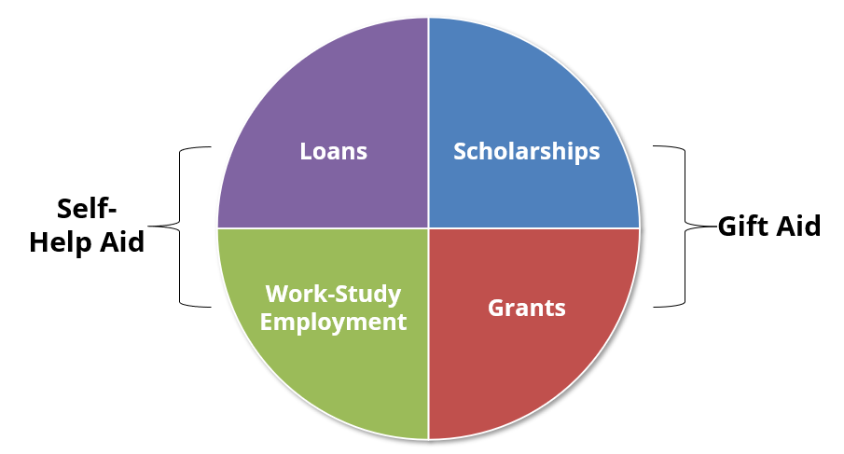
Types of Financial Aid

Slide 5
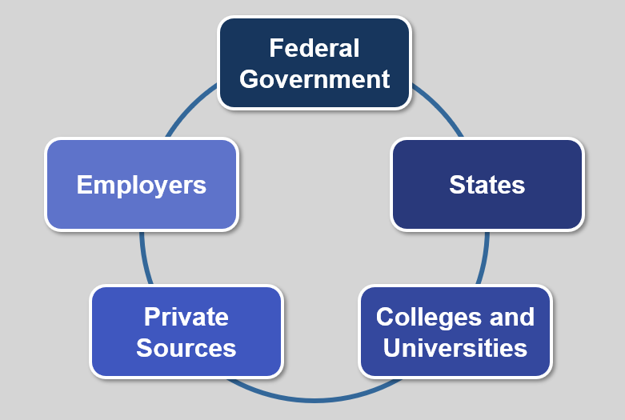
Sources of Financial Aid

Slide 6
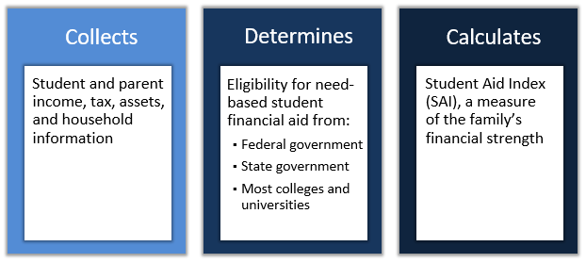
What is the Free Application for Federal Student Aid?
Gateway to need-based student financial aid from:
  Federal Government
  State Government
  Colleges & Universities

Slide 7
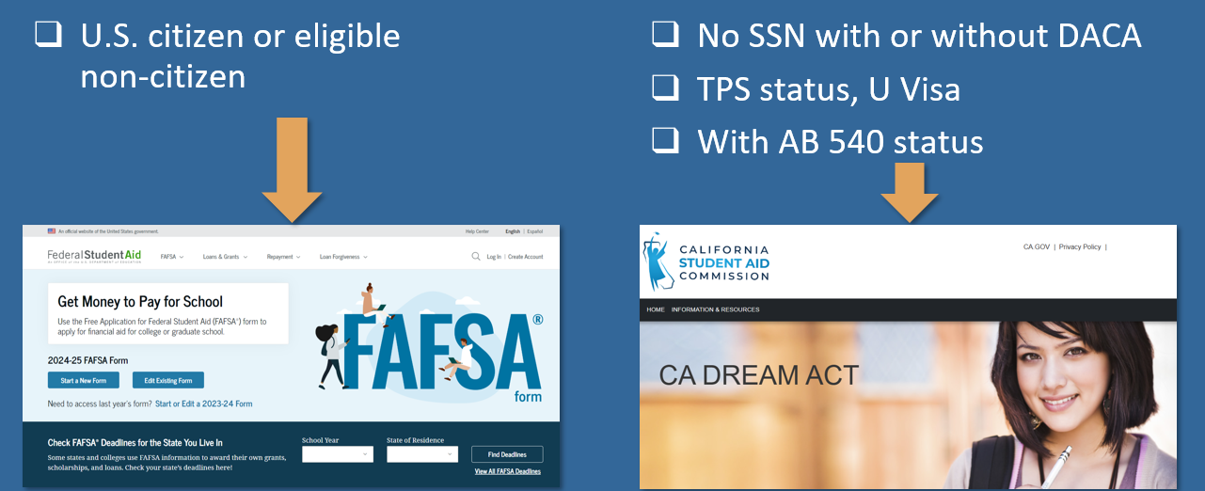
Which Financial Aid Application to Submit?

Slide 8

Compelling reasons to File A FAFSA
Even if you don’t think you will qualify for need based aid, consider the following:
Regardless of income level, a FAFSA must be filed to receive free CA Community College tuition
Allows for access to government student loans
Allows for the opportunity to secure need-based aid if life circumstances and/or financial circumstances change (special circumstances)
You can qualify for the CA Middle Class Scholarship even if you earned up to $234,000 of income and have up to $234,000 of assets
Some schools will not consider you for merit scholarships until you have submitted a FAFSA
FAFSA completion required for CA high school seniors unless opt-out

Slide 9


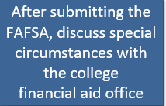
Special Circumstances – appeal for more financial aid
Family’s financial circumstances have changed (even mid-year) or differ from the typical family
  Changes to family income or assets
  Recent unemployment
  High dependent care expenses
  Housing change due to homelessness
  High unreimbursed medical or dental expenses
  One-time events (e.g., a bonus) that do not reflect ability to pay

Slide 10
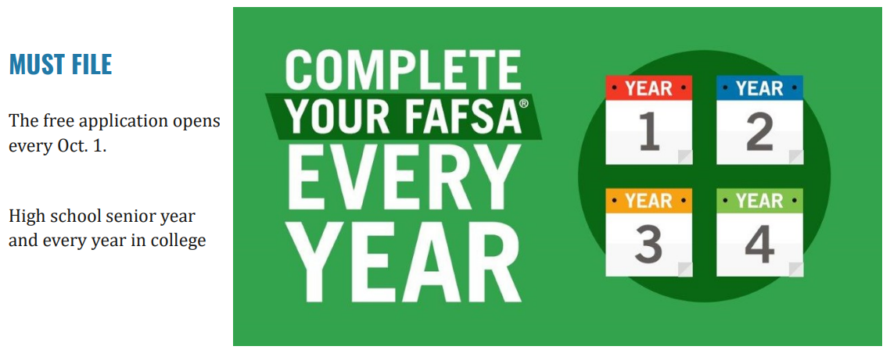
WHEN TO FILE THE FAFSA?

Slide 11
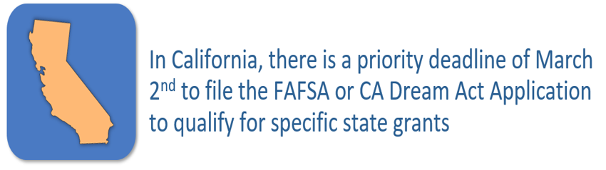
WHEN TO FILE THE FAFSA? (continued)
File as soon as possible to qualify for more grants/scholarships from the school
  Can even file the FAFSA before submitting college admissions applications

Slide 12
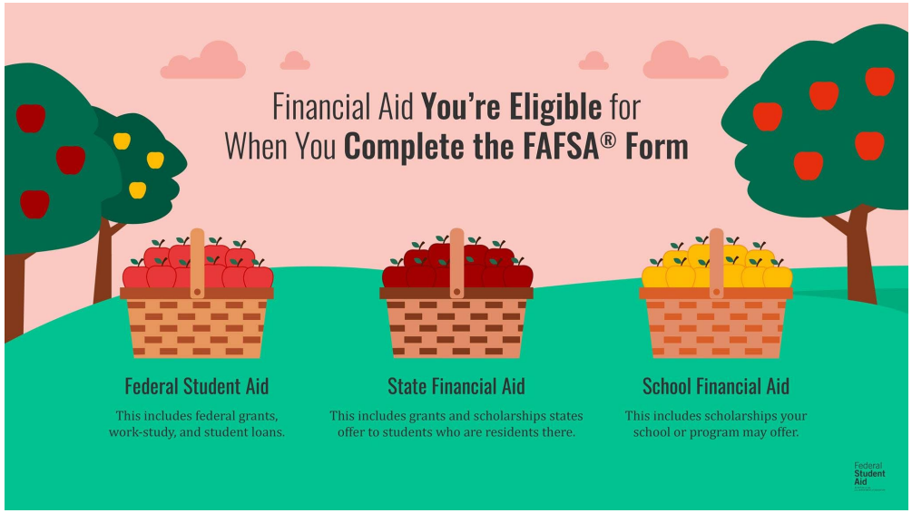
Multiple Agencies Get FAFSA Data Simultaneously

Slide 13
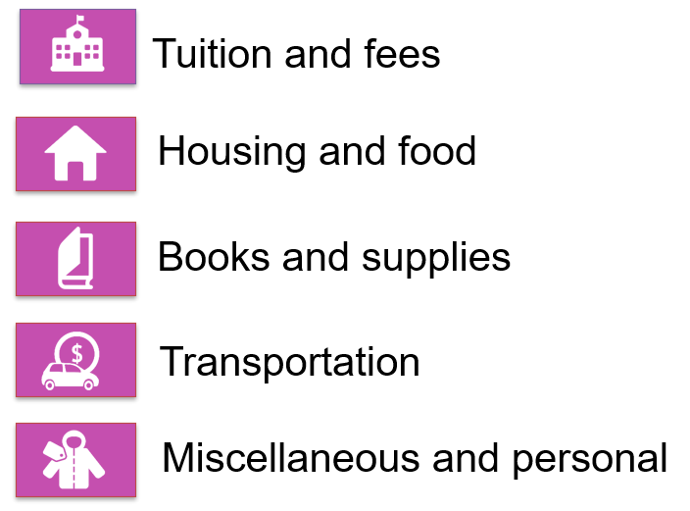
what is cost of attendance? (coa)

Slide 14
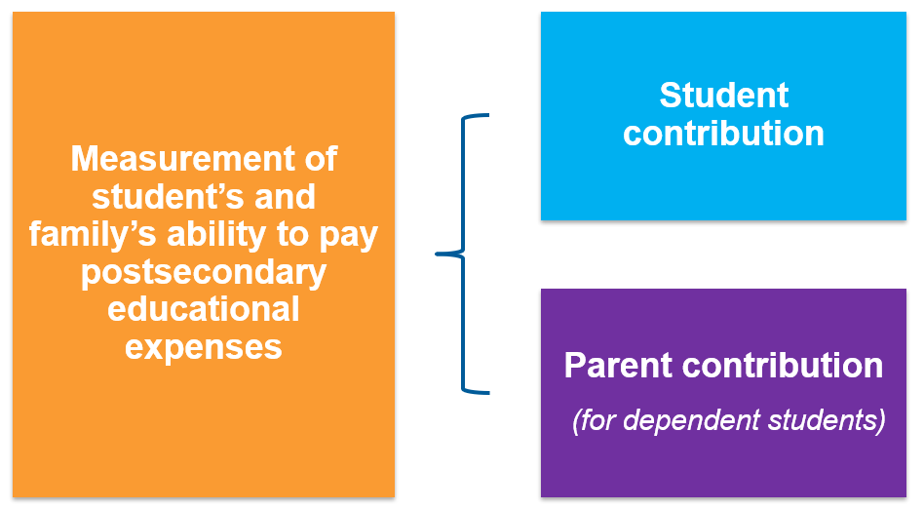
what is the student aid index? (sai)

Slide 15

Financial Aid OFFErs
Applied to the school
+ accepted to the school
+ listed the school on your FAFSA (can list up to 20)
= You will get a Financial Aid Offer from the school
Example:
  COA $29,000 (School Cost of Attendance)
  -SAI - $ 4,000 (Your Student Aid Index)
Financial Need $25,000
Schools offer varying amounts of financial aid, some more generous than others
Applying to multiple schools gives you more financial aid offers to consider

Slide 16
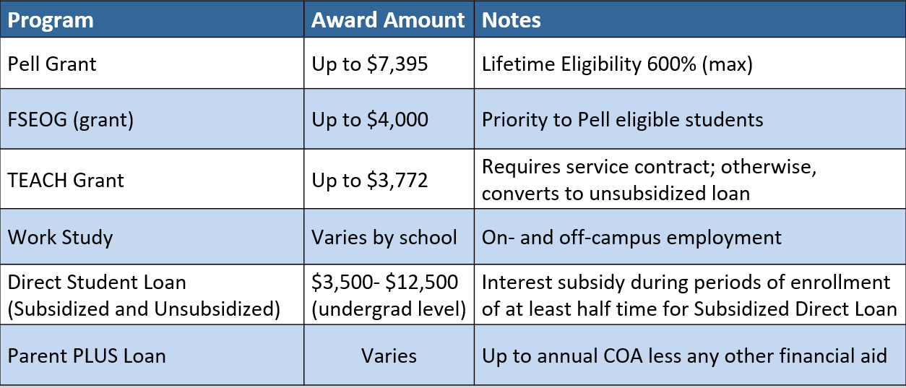
Financial AiD opportunities
Federal Aid Programs - 2024-2025 Information

Slide 17
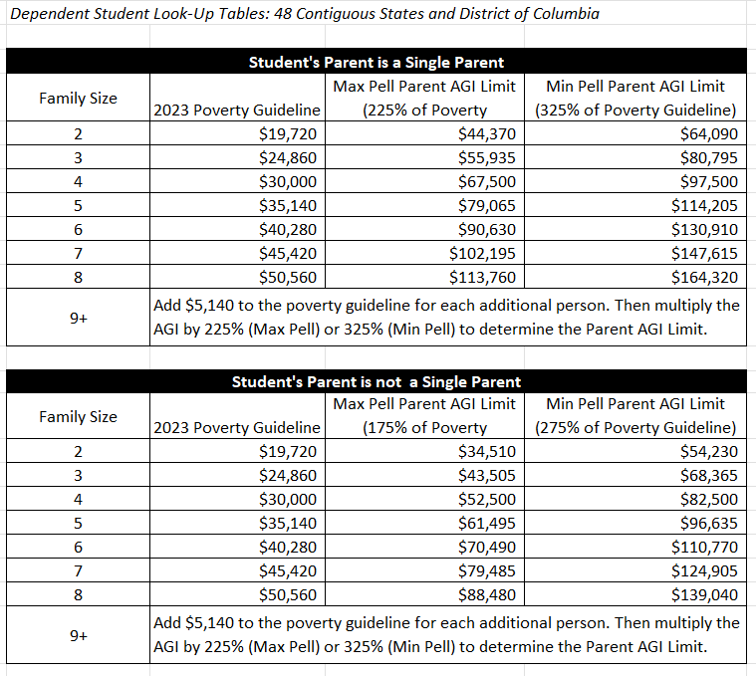
Financial AiD opportunities
Federal Pell Grant Program Aid Program - 2025-2026 Information

Slide 18

Financial AiD opportunities
Federal Aid Programs - 2025-2026 Information
  How is a Pell Grant Award determined?
    An automatic Maximum Pell Grant Award of $7,395 per year – Max Pell
    (see eligibility chart)
    SAI-calculated Pell Grant
      Maximum Pell Grant (i.e., $7,395) – SAI = Pell Award
    A Minimum Pell Grant Award of $740 – Min Pell (i.e., 10% of Max Pell)
    (see eligibility chart) – Min Pell
  Federal Student Aid Estimator
    studentaid.gov/aid-estimator
      Calculates Student Aid Index (SAI) and gives federal financial aid estimate (Pell Grant)

Slide 19


Financial AiD opportunities
California Aid Programs* - 2024-2025 Information
  Cal Grant $1,648 - $16,084/year (4 years max)
  California College Promise Program
    First 2 years of community college tuition-free for lower income students who file a FAFSA/CADAA
  Shasta Promise – Shasta College
    Full-time student + file a FAFSA/CADAA = free tuition (regardless of income)
  California Middle Class Scholarship (MCS) - Up to $234,000 income and $234,000 assets
  *Applies to all accredited and approved schools in California

Slide 20
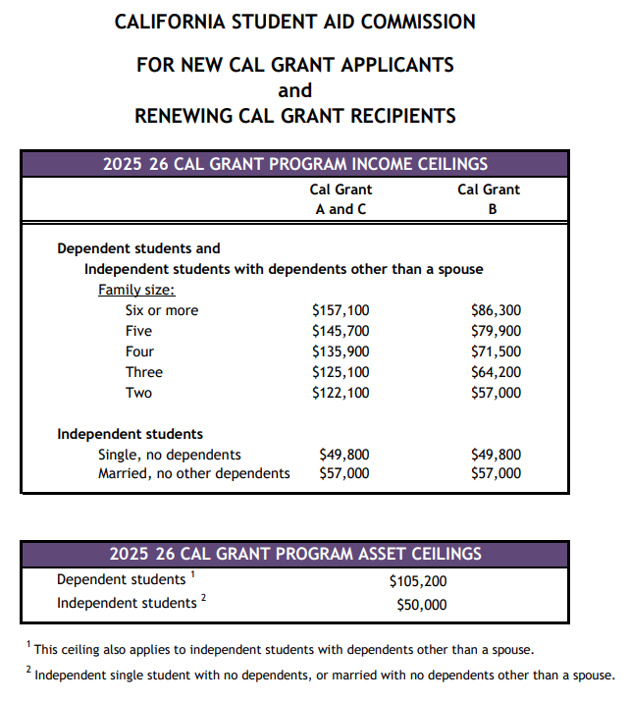

Cal Grant
Income &
Asset
Ceilings
CA is working on implementing Cal Grant reform beginning with the 2025-2026 academic year. If reform takes place, the income and asset ceilings will change. A decision is expected in May 2025.

Slide 21
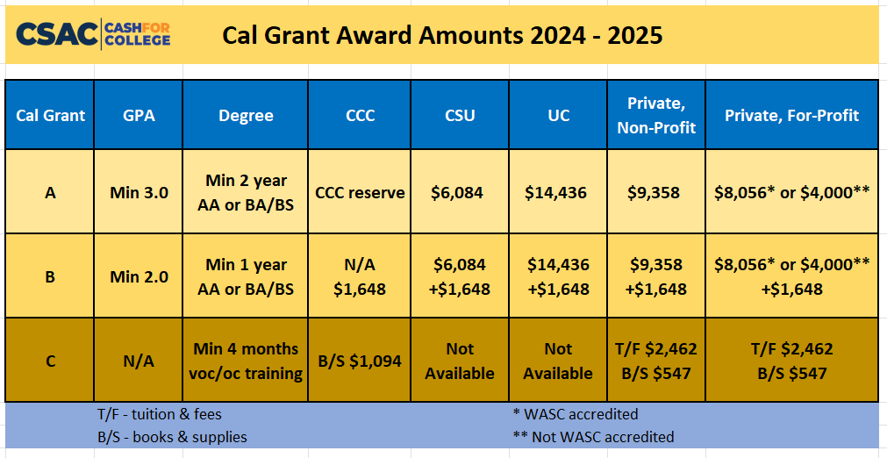

Slide 22

California middle class scholarship
  Students enrolled at a UC or CSU whose income exceeds limits for Cal Grant will automatically be considered for the California Middle Class Scholarship
    If the student’s FAFSA or CADAA is submitted by March 2
  Students with family income and assets up to $234,000 may be eligible
  Award determination is based on a complicated formula
  This is a last dollar award, so all other grants, scholarships, fee waivers will be applied first

Slide 23
Financial AiD opportunities
Institutional Aid
  Scholarships & Grants
    Need-based (financial need) and/or
    Merit-based (student talent or skill)
    Scholarships & Grants vary by school
      Apply to several schools to see several financial aid offers
Out of State Schools
  Western Undergraduate Exchange (WUE)
    Enables students in 16 western states & territories to enroll at 160+ participating public schools outside their home state and pay reduced tuition.
      WUE rate of 150% in-state tuition (or less)

Slide 24
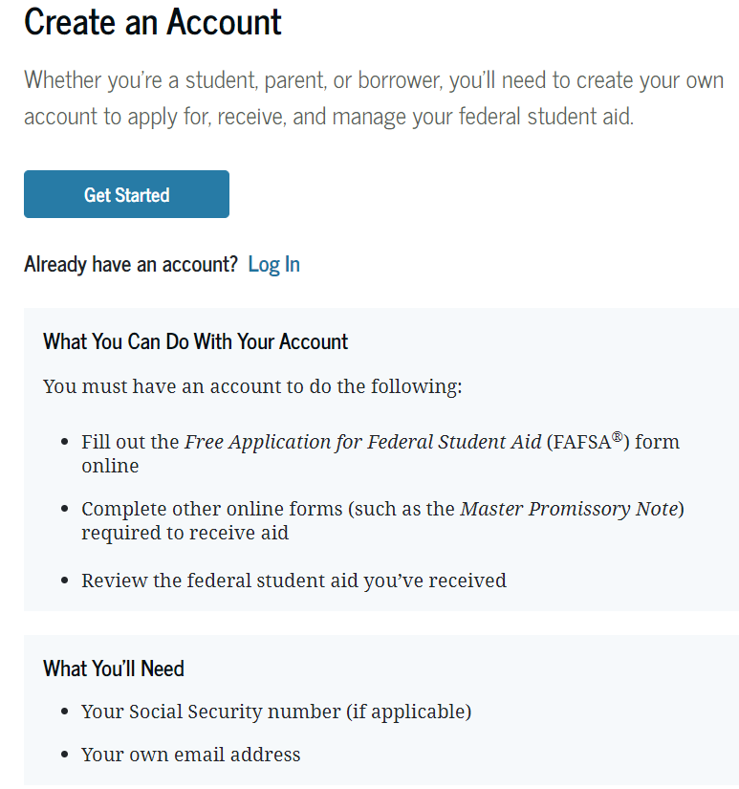

StudentAid.gov Account Needed to File FAFSA (Also Called the FSA ID)
  Federal Student Aid Help Line
(800) 4-FED-AID
(800-433-3243)

Slide 25
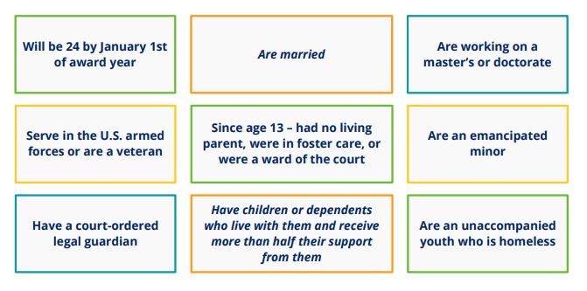
A student is considered to be Independent if any one of these apply:
Otherwise, they are considered to be Dependent

Slide 26
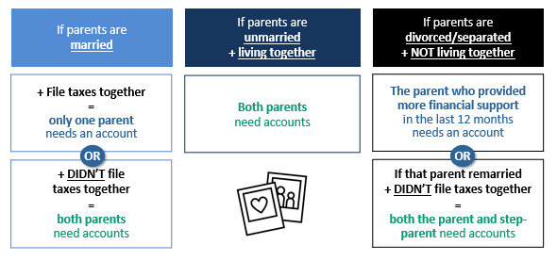
Which of a Dependent Student’s Parents Need an FSA ID?

Slide 27
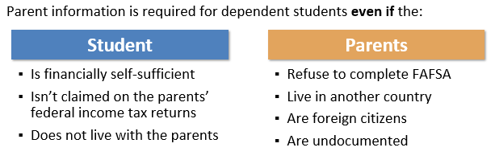
What if Parents Won’t Complete the FAFSA?

Slide 28

What if Parents Won’t Complete the FAFSA? (cont’d)
If parent information is not provided for a dependent student, the most financial aid that the student can get is unsubsidized Federal Loans unless the college financial aid administrator performs a dependency override
Dependency overrides are rare and generally involve
an involuntary dissolution of the family relationship, such as:
  Left home due to an abusive or threatening environment
  Are abandoned or estranged from their parents
  Have refugee or asylee status and are separated from their parents
  Are a victim of human trafficking
  Are incarcerated, or their parents are incarcerated and contact with the parents would pose a risk to the student
  Are otherwise unable to contact or locate their parents

Slide 29
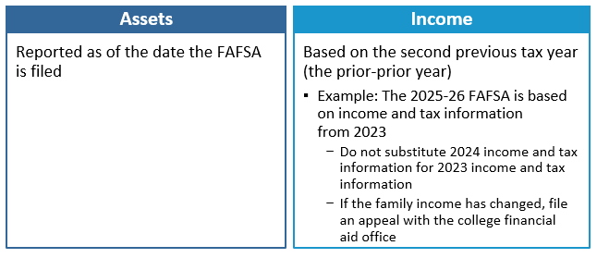
Which year’s information is reported?

Slide 30

Sai calculation - Income
(For 2025-2026 School Year use 2023 Tax Return information)
Parent’s
  When the student is considered “dependent” for FAFSA purposes
Student’s
  $11,510 is “protected” (for the 2025-2026 academic year)
  50% of income greater than $11,510 may be added to the SAI
Start with your Adjusted Gross Income (AGI) and include:
  IRA deductions & payments to self-employed SEP, SIMPLE, Keough, and other qualified retirement accounts
  Foreign earned income if exempt from taxation
  Tax Exempt Interest Income
  Untaxed Portions of Pensions (excluding rollovers)
  Untaxed Portions of IRA Distributions (excluding rollovers)

Slide 31

Exempt from asset reporting
Dependent student meets one of these criteria:
  The student qualifies for a Maximum Pell Grant
  The student’s parents’ 2023 combined AGI is less than $60,000 and
    They do not file a Schedule A, B, D, E, F, or H, and
    They do not file a Schedule C, or
      They file a Schedule C with net business income of not more than a $10,000 loss or gain
  Receiving any 1(or more) of 9 federal benefits in 2023 or 2024
    9 named programs including:
      “Free or reduced-price school lunch”
        A universal program in all CA TK-12 public schools
          Check the federal income guidelines for FAFSA eligibility (next slide)

Slide 32
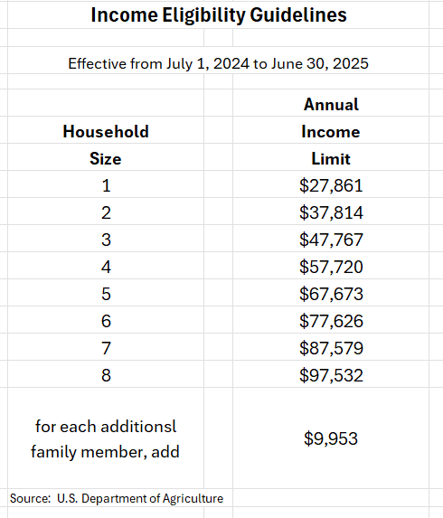
Free and reduced-price school lunch

Slide 33
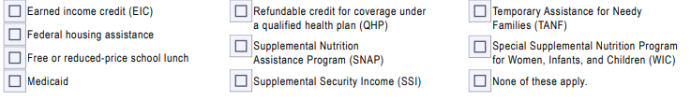

Fafsa definition of federal benefits received
At any time during 2023 or 2024, did the parent or anyone in their family receive benefits from any of the following federal programs?
EIC can be found on line 27 of your 2023 or 2024 1040 tax return
Medi-Cal is the CA version of Medicaid
QHP credit can be found on line 9 of Schedule 3 of your 2023 or 2024 tax return
CalFresh is the CA version of SNAP
SSDI is not the same benefit as SSI
CalWORKs is the CA version of TANF

Slide 34

What Assets to declare for FAFSA
FAFSA Assets Do Not Include:
Home equity (in primary home)
Retirement accounts (IRA, 401k, 403b, Roth, etc.)
Life insurance & annuities
Personal vehicles, boats, firearms, household goods, jewelry, tools etc.
Examples of FAFSA assets to declare:
Cash, Savings, Checking
Net worth of land, investment real estate, etc.
Stocks/Bonds/Trusts/Other Investments (not in retirement accounts)
Net worth of businesses and/or for-profit agricultural operations
College savings plans/529 plans – do not include the value of siblings’ plans (report as an assets of the parents)
Annual child support received in most recent completed calendar year
Note: if net worth is negative, enter zero

Slide 35

sai Calculation – Assets
Parent
  When the student is considered “dependent” for FAFSA purposes
Student
  20% of student assets may be added into the SAI
    Assets are often best kept out of the name of the student
  Assets are calculated as of the day the FAFSA is filed

Slide 36

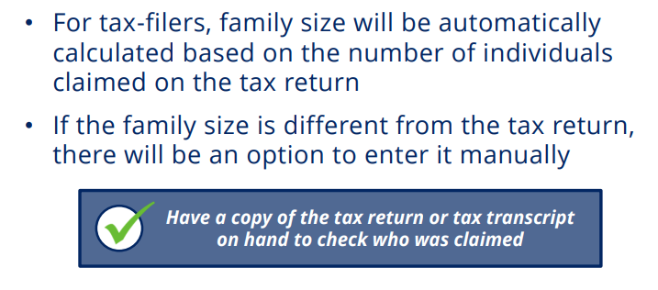
SAI Calculation - Family size

Slide 37
Fafsa definition of Family size
How many people are in the parent’s family?
  Include
    the parent (and spouse or partner)
    the student
    the parent’s dependent children (even if they live apart because of college enrollment)
    and other people living with the parent now
Include these dependent children and other people only if the parent will provide more than half of their support between July 1, 2025, and June 30, 2026

Slide 38

I have filed my fafsa – what happens next?
After the student completes the online FAFSA, a FAFSA Submission Summary (FSS) is sent to the student
  An electronic FSS is sent if a student email address is provided
  A paper summary is mailed if no student email address is provided
An electronic copy of the FAFSA data is sent to each college or university listed on the FAFSA
Student should keep a copy of the FSS with other financial aid documents

Slide 39

Didn’t GET enough financial aid? Consider these options
  Negotiate: Ask the college or university for more financial aid
  Scholarships: More detail on future slide
  Special Circumstances Consideration: More detail on prior slide
  Student job: Work study or on-campus or off-campus
  Payment Plans: Your school may have plans to avoid lump sum payments, allowing for several payments throughout a semester
  Parent Savings: Food, gas, insurance savings while student is in college
  Family resources: Savings, sell assets, 2nd mortgage, credit cards, etc.
  Current Income: Allocate more to education expenses
  Additional Loans: Government PLUS loans or private loans

Slide 40

Reducing College Costs
Career Planning before/during college
  Changing your major (or college) costs time and money!
  Internet research, informational interviews, job shadowing
  Avoid dropping classes and focus on graduating on time
Graduate on Time
  The longer you are in school, the more it will cost you
Apply for scholarships
  Priority on local (smaller applicant pool)
  If you are eligible, apply!
Buy used textbooks or rent them
Borrow responsibly
Use College & Career OPTIONS tools
  to evaluate and compare award offers
  project costs over time
  make decisions based on objective factors
Consider an alternative college
  Community Colleges can be great options

Slide 41

What About Scholarships?
Your High School
  Counselors know about scholarships given previously to their students
The McConnell Foundation – McConnell Scholars Program
The Ford Family Foundation – Ford Scholars Program
  Siskiyou County high school students only
Community Foundation of the North State
  Approximately 30 scholarship opportunities
Reach Higher Shasta
  Scholarship Database
    Over 60 entries
Local Chambers of Commerce, Rotary Clubs, Civic Groups, etc.
National Scholarships (lots out there/lots of competition)
  Thousands of scholarships identified by each search engine (3 examples)
    Sallie Mae
    Fastweb
    Big Future
Your College/University Admissions and/or Financial Aid Office

Slide 42
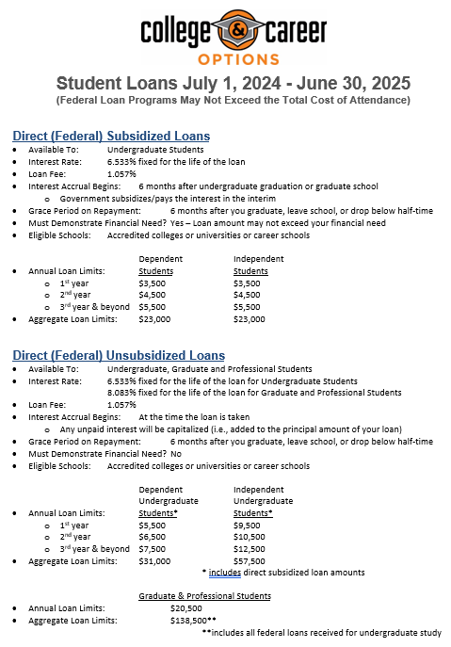


Slide 43
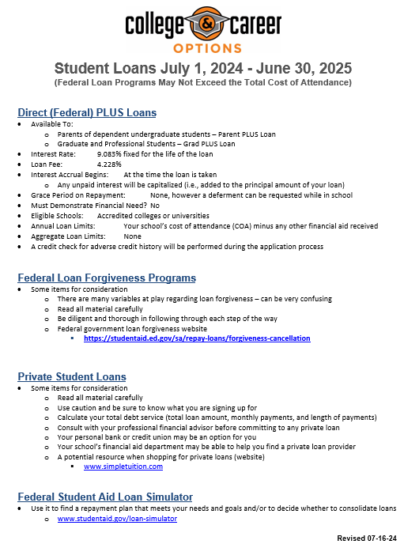


Slide 44

College & Career OPTIONS Financial Aid Tools and Resources

Slide 45
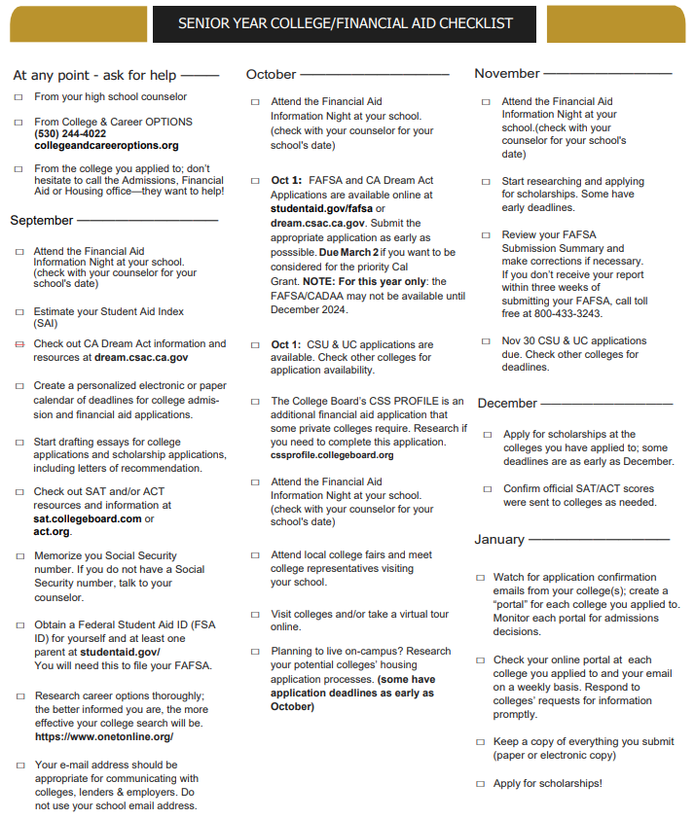



Slide 46
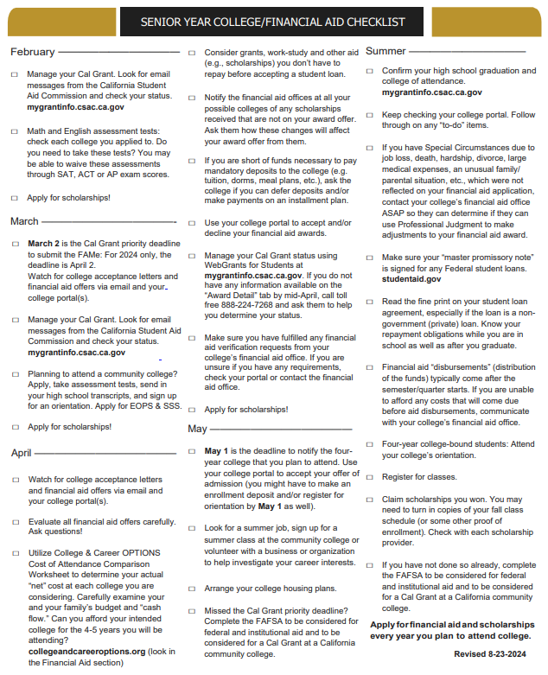



Slide 47

College & career OPTIONS Financial Aid Services
College & Career OPTIONS is a local educational partnership that provides services at no cost to students of all ages who live in Modoc, Shasta, Siskiyou, Tehama or Trinity counties. Financial Aid services are specifically designed to meet individual needs.
College & Career OPTIONS does not guarantee any specific grants, scholarships, loans or government funding.
Students who receive services, and their parents or other responsible adults, are expected to provide accurate and complete information to advisors for all applications for financial aid. The best options for financial aid are based on up-to-date information.
Our advisors are not financial professionals. We urge students and families to verify information and weigh the options before making financial decisions.
It is our policy to maintain the privacy of every student who accesses services through College & Career OPTIONS. We do not share information with any outside agencies, companies or individuals. With the student’s permission, we may discuss a student’s progress with other educators and/or college admissions and/or financial aid officers for the benefit of the student.
We welcome suggestions, comments and feedback of any kind. The best services are the result of diligent efforts by everyone.
Thank you for allowing us to be of assistance to you.

Slide 48

Some Considerations & Reminders
Cal Grant is good for 4 academic years, including Community College
  Use it wisely
Meet all deadlines - Cal Grant has a March 2 filing deadline (except for California community college attendance, which is September 2)
Include at least one California college/university on the FAFSA/CADAA, even if the student plans to study out of state
After filing the FAFSA/CADAA, check CSAC’s WebGrants 4 Students website to track progress on California aid (mygrantinfo.csac.ca.gov)
Department of Education College Scorecard
  Compare schools – cost, graduation rate, employment rate, average amount borrowed, loan default rate
  www.collegescorecard.ed.gov
Reach out to College & Career OPTIONS if you need assistance
Follow College & Career OPTIONS on social media @collegeandcareeroptions

Slide 49



WITH GRATITUDE!!!
A huge thank you to these
College & Career OPTIONS funders!!!
Because of their generosity, all services provided by College & Career OPTIONS personnel are free to North State families

Slide 50


Thank you!!!
We are always trying to improve our effectiveness.
  If you have suggestions for improvement, please see me or call me or email me
  Brad Williams
  Director of Financial Aid Services
  College & Career OPTIONS
  Email: bwilliams@collegeandcareeroptions.org
  Phone: 530-768-5103
Thank you for attending this presentation and for your interest in financial aid

