Slide 1
Students – Enter a chance to win a visa gift card
High School students are eligible to be in a drawing for a $50 Visa gift card by doing the following:
Attend the workshop
Completely fill out the sign-in sheet
Stay until the end of the workshop
Gift card will be selected through random drawing of eligible students

Slide 2
Financial Aid 2025-2026
Robert Adams - radams@collegeandcareeroptions.org
530-244-4022 530-768-5107
@collegeandcareeroptions on social media
WWW.COLLEGEANDCAREEROPTIONS.ORG

Slide 3
Providing college and career preparation services
Serving students and families since 2003
A non-profit organization securing grant funding to be able to provide free services and resources to your county.
Southern Oregon; Douglas - Klamath
Three primary service lines
Academic/College Preparation
Career Exploration
Financial Aid
Appointments available 530-244-4022

Slide 4
Goals for Today
Take the mystery out of the financial aid process and provide a basic understanding of how financial aid works
Provide an understanding of how to maximize your financial aid potential
Identify resources for help and assistance
Notes:
My main goal is the take the mystery out of financial aid and hopefully help you understand how it works. Your goal is to ask questions.

Slide 5
quick tips for
Getting Started
Stay Organized
Legal Name
Email
Store usernames, passwords, deadlines
Use your legal name on all applications
Use professional email and check it
Notes:
Going to walk you through the process of financial aid before we get into the details.

Slide 6
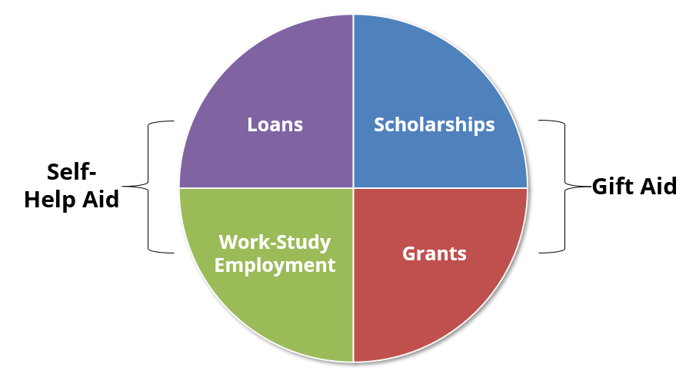
Types of Financial Aid
Notes:
I am not sure that loans should be called financial aid but the federal government calls it that and I don't want you to stumble into taking out a loan.

Slide 7
Sources of Financial Aid
Notes:
State Colleges and Universities have money that they can give for financial support
Private colleges have endowments that they can also give in the form of scholarships and so forth.

Slide 8
What is the Free Application for Federal Student Aid FAFSA?
Notes:
Everything we have talked about starts with filling out a FAFSA. Even if you think that you don't qualify you might qualify for a state or private college scholarship and you can't get that offer unless you fill out the FAFSA
When you get your calculated SAI most people think it is too high. How much do they think we can pay? Did I make a mistake on filling it out? You might have made a mistake but most likely you didn't and that is the number.. I will explain how that works as we go along.

Slide 9
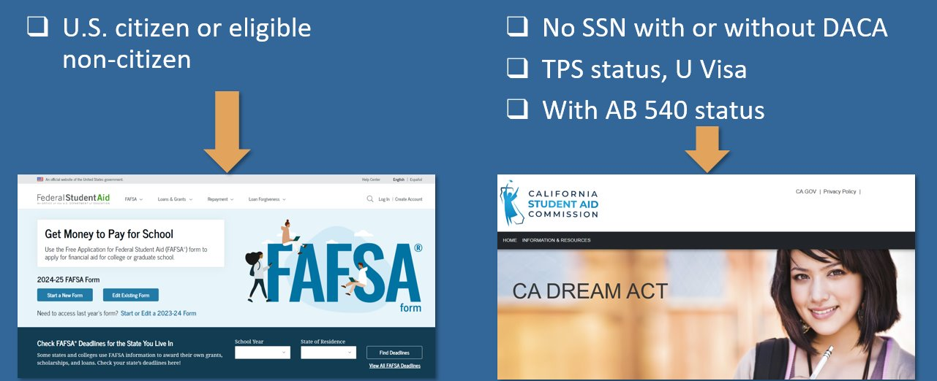
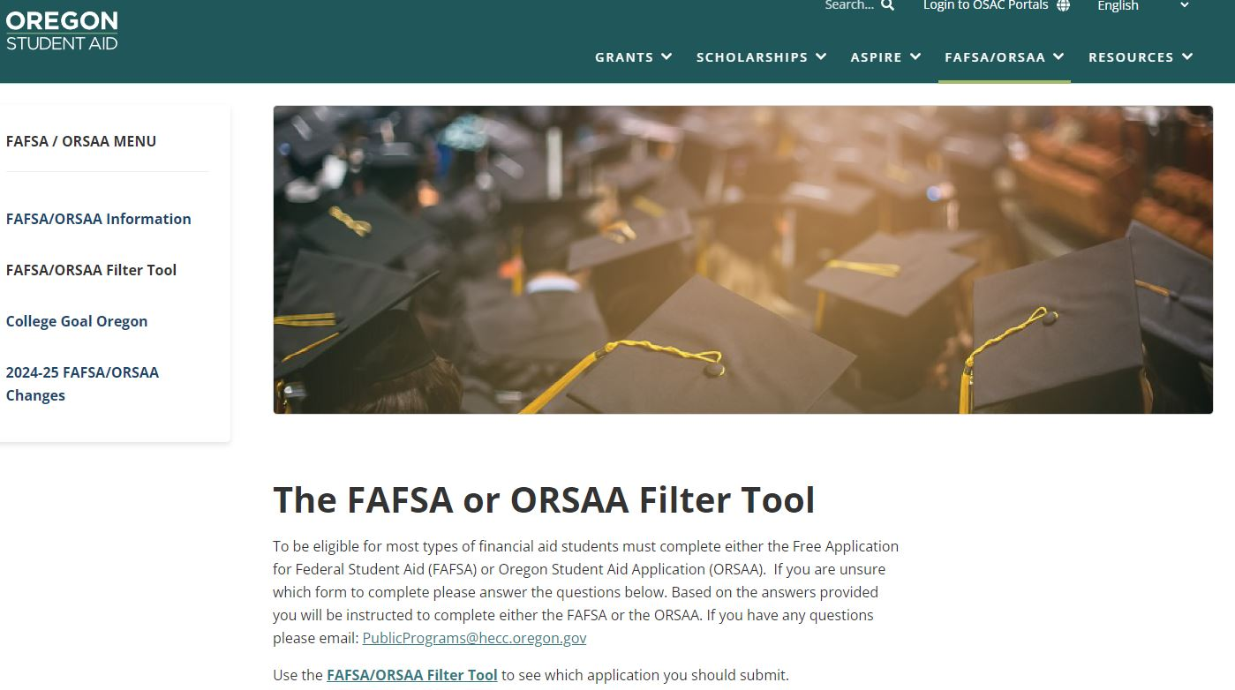
Which Financial Aid Application to Submit?
https://studentaid.gov/
https://oregonstudentaid.gov/fafsa-orsaa/fafsaorsaa-filter-tool/

Slide 10
Compelling reasons to File A FAFSA
Even if you don’t think you will qualify for need based aid, consider the following:
Regardless of income level, A FAFSA must be filed to receive Oregon grants and scholarships.
High School seniors need to fill out to qualify for the Oregon Promise Community College Grant.
Allows for access to government student loans
Allows for the opportunity to secure need-based aid if life circumstances and/or financial circumstances change (special circumstances)
Some schools will not consider you for merit scholarships until you have submitted a FAFSA
Notes:
I have heard lots of reasons why people don't want to fill out the FAFSA: Too much time, hate the government etc... but here are some reasons I think you should fill it out.
Parents you will like this... Student loans in student name with no parent co-signer at a very low rate.

Slide 11
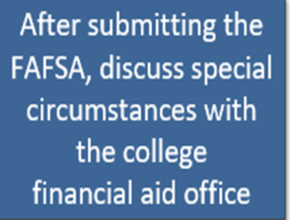
Special Circumstances – Appear for more financial aid
Family's financial circumstances have changed (even mid-year) or differ from the typical family.
Changes to family income or assets
Recent unemployment
High dependent care expenses
Housing change due to homelessness
Unreimbursed medical or dental expenses not covered by insurance
One-time events (e.g. a bonus) that do not reflect ability to pay

Slide 12
WHEN TO FILE THE FAFSA?
Notes:
Most important thing to remember is that you have to fill it out every year when you are in college, university, or tech school.

Slide 13
WHEN TO FILE THE FAFSA? (continued)
File as soon as possible to qualify for more grants/scholarships from schools.
You can even file the FAFSA/ORSAA before submitting college admissions applications
Funds are limited
Oregon Opportunity Grant - Awards given to students with the greatest financial need, based on their SAI. Awards start in spring until funds are exhausted for the year.
SUBMIT FAFSA or ORSAA as soon as possible after October 1 each year.
Oregon Promise Grant
Complete all of the steps by your application deadline (varies by graduation date). For most students, you MUST apply during your senior year of high school (before you graduate), or immediately after GED® test completion.

Slide 14
Multiple Agencies Get FAFSA Data Simultaneously
Notes:
When you complete the FAFSA it first goes to the Federal Student Aid Commission and they determine eligibility for aid up to $7395
Then it goes to the State Financial Aid Commission to determine state aid
And last to the school financial aid department that you listed on your FAFSA and applied to. If the school needs more information they will ask.

Slide 15
Cost of
Attendance
Cost of Attendance
(COA)
“Sticker Price” to attend a college
Average college costs including tuition, fees, books, misc. and living expenses
It is NOT your bill
Costs can vary from school-to-school
Used to determine a student’s financial need calculation
Notes:
Notes:
Cost of Attendance is not what students and families should expect to pay, think of it like a “estimated sticker price” for college or an average price to attend a particular college. The actual cost to attend college will depend on different circumstances like financial aid and living situations.
The Cost of Attendance will differ from school to school because the cost to got to PCC is different then the cost to attend Lewis and Clark or PSU.
COA is used to determine a student’s financial need calculation.
A Cost of Attendance (COA) document for the school year is available on HECC website which includes Oregon community colleges, Oregon public universities, and most Oregon-based private non-profit colleges. You can also find a COA list in the ECMC booklets or on institutions websites or via catalogs.

Slide 16
what is cost of attendance? (coa)
Notes:
Oregon State Snapshots for each college or university - https://www.oregon.gov/highered/strategy-research/pages/snapshots.aspx

Slide 17
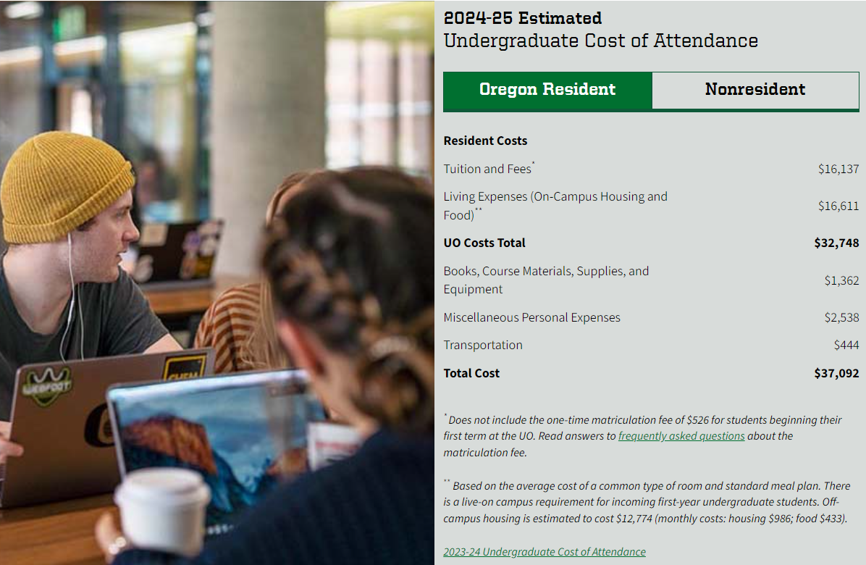
University of Oregon Cost of Attendance 2024-2025 (ESTIMATED)
Notes:
Can look this up on any university or college site

Slide 18
(ESTIMATED) Cost Of Attendance Comparison 2024-2025 Douglas County
UMPQUA Community College (OR Community College)
$26,323*
$6,105
Oregon State University (OR Public 4-year)
$34,965**
$14,497
University of Oregon (OR Public 4-year)
$37,092**
$16,137
Willamette University (Private)
$67,456**
$25,440
*Living at Home
**Living on Campus
Notes:
Don’t give up on private schools

Slide 19
(ESTIMATED) Cost Of Attendance Comparison 2024-2025 Klamath County
Klamath Community College (OR Community College)
$30,905**
$6,300
Oregon Institute of Technology (OR Public 4-year)
$23,625**
$11,987
University of Oregon (OR Public 4-year)
$37,092**
$16,137
Willamette University (Private)
$67,456**
$25,440
*Living at Home
**Living on Campus
Notes:
Don’t give up on private schools

Slide 20
what is the student aid index? (sai)
Notes:
Student Aid Index (SAI) replaces Expected Family Contribution (EFC).
The SAI is a number that determines each student’s eligibility for certain types of federal student aid. UTD will also use it to determine a student’s eligibility for state and institutional aid. The SAI is calculated by using more simplified need analysis formulas that use information provided on the FAFSA and, in most cases, federal tax information retrieved directly from the Internal Revenue Service (IRS).
It will be possible for an SAI to be a negative number, with a minimum SAI of -1,500 instead of 0.

Slide 21
Financial Aid OFFErs
Process for financial aid:
Applied to the school
+ accepted to the school
+ listed the school on your FAFSA/ORSAA (can list up to 20)
= You will get a Financial Aid Offer from the school
Example:
COA $31,000 (School Cost of Attendance)
-SAI - $ 5,000 (Your Student Aid Index)
Financial Need $26,000
Schools offer varying amounts of financial aid, some more generous than others
Applying to multiple schools gives you more financial aid offers to consider

Slide 22
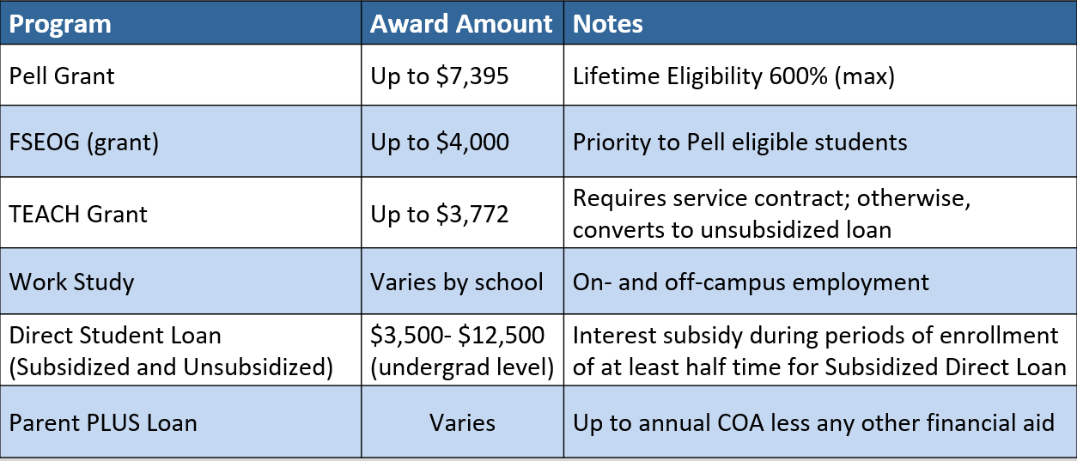
Financial AiD opportunities
Federal Aid Programs - 2025-2026 Information
Notes:
Lets move on to how much you can actually qualify for. Start with Federal Aid
Two types of loans.

Slide 23
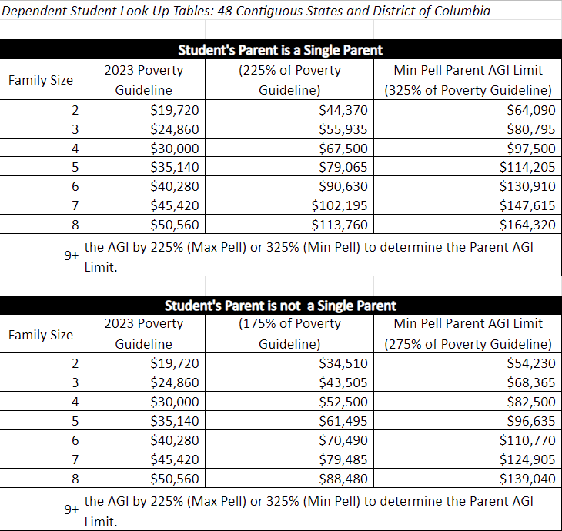
Financial AiD opportunities
Federal Pell Grant Program Aid Program - 2025-2026 Information
Notes:
Is on line 11 of tax return (AGI) is less than the amount in middle column then max Pell. If over middle but below right column then at least minimun pell 10% of max pell.

Slide 24
Financial AiD opportunities
Federal Aid Programs – 2025-2026 Information
How is a Pell Grant Award determined?
An automatic Maximum Pell Grant Award of $7,395 per year – Max Pell
(see eligibility chart)
SAI-calculated Pell Grant
Maximum Pell Grant (i.e., $7,395) – SAI = Pell Award
A Minimum Pell Grant Award of $740 – Min Pell (i.e., 10% of Max Pell)
(see eligibility chart) – Min Pell
Federal Student Aid Estimator
studentaid.gov/aid-estimator
Calculates Student Aid Index (SAI) and gives federal financial aid estimate (Pell Grant)
Notes:
Wouldn't it be great to know how much you mnight get?

Slide 25
Financial AiD opportunities
Oregon Aid Programs* - 2025-2026 Information
Oregon Opportunity Grant (OOG) $900 - $7,524
Oregon Promise Grant – June 3, 2025
First 90 credits (attempted or completed) of community college - $2,124 - $4,422
FAFSA/ORSAA & Oregon Promise application
Oregon Tribal Student Grant – April 5, 2025
At least half-time student + file a FAFSA/ORSAA + Oregon Tribal Student Application + Tribal Enrollment Verification Form
*Applies to all accredited and approved schools in Oregon

Slide 26
Oregon Opportunity Grant
Awards given to students with the greatest financial need, based on their SAI. Awards start in spring until funds are exhausted for the year.
SUBMIT FAFSA or ORSAA as soon as possible after October 1 each year.
Students enrolled full-time for a full-year in 2025-26:
Community College $900 - $3,900
BAS Program at Community College $1,260 - $5,904
4-Year College or University $1,788 - $7,524
Submit the 2025-26 FAFSA or ORSAA as soon as possible to apply for 2025-26 Oregon Opportunity Grant. Awarding for 2024-25 has started and will continue until funds are depleted.
Notes:
What percentage of those that qualify get funded. Maybe they never run out of money. Find out if they actually run out and when.

Slide 27
Oregon Promise Grant
Complete all of the steps by your application deadline (varies by graduation date). For most students, you MUST apply during your senior year of high school (before you graduate), or immediately after GED® test completion
How to Apply:
Submit the Oregon Promise application in the OSAC Student Portal.
Submit the FAFSA or ORSAA for the year that you will start college.
List at least one Oregon community college on the FAFSA or ORSAA.
Awarding Information for Class of 2025
Oregon Promise Grant awarding will begin in Spring 2025 to new students (Class of 2025) who will begin college in Fall 2025. APPLY SPRING OF 2025. Must attend within 6 months of HS/GED graduation.
2024: At this time, the Final SAI limit of 25,000 for new students. Regardless of income, all students must apply by their deadline in order to be considered for the grant. Most students must apply by June 1. All students only have one opportunity to apply for Oregon Promise, based on their graduation date.

Slide 28
Oregon tribal student grant
Student Eligibility
Enrolled member of one of the nine federally recognized tribes in Oregon
Enrolled at least half time in eligible Oregon college or university.
Complete Oregon Tribal Student Grant application in the OSAC Student Portal.
Submit FAFSA Or ORSAA
Working towards first degree or credential at current level.
The final deadline to apply for the 2025-26 academic year is April 4, 2025.
Award determination is based on other awards (Pell, OOG, OPG) as well as Cost of Attendance (COA)
This is a last dollar award, so all other grants, scholarships, fee waivers will be applied first

Slide 29
The OSAC
Create a Student Account
Student Portal
Applications and Awards:
Oregon Promise Grant
Chafee Grant
Child Care Grant
Oregon Tribal Student Grant
OR National Guard State Tuition Assistance
OSAC Scholarships
OregonStudentAid.Gov
Notes:
Notes-
The OSAC portal is where students can apply for a variety of grants and scholarships administered by the State of Oregon. OSAC recommends students create a portal account as soon as possible so that they are ready for the scholarship/grant application process.
Students are encouraged to check their email and portal account regularly during the spring to check for any award notifications. Can apply as soon as Freshman year but this isn’t the application for the grants. Need to get back in and see what they can apply for. Then they apply every year.

Slide 30
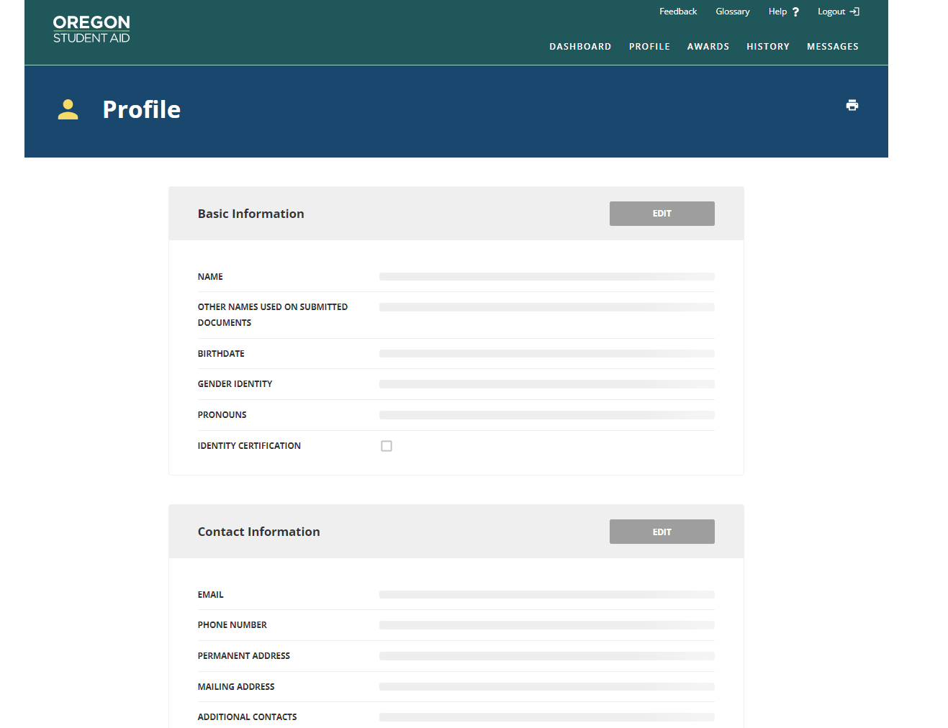
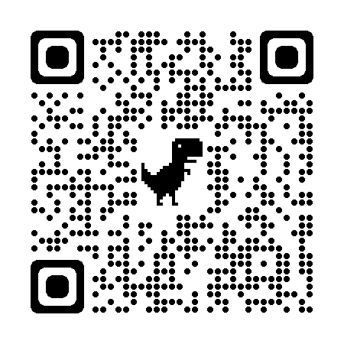
creating an
OSAC Portal Account
Use your legal name, make sure it is the same name as the one on your FAFSA/ORSAA
Password must be 12 characters including digits, upper case letter, lower case letter, and symbol (e.g. @$%)
https://app.oregonstudentaid.gov/
Notes:
Notes-
Creating an OSAC portal account is easy, but a few things can be tricky.
Make sure to use your legal name and the name that matches your FAFSA or ORSAA application
Remember your password is 12 characters and has specific requirements
Students should sign up with a personal email account, not a high school or college-operated email account, so that they will have access to their portal account indefinitely. Students are encouraged to check their email and portal account regularly during the spring to check for any award notifications.
Remember to stay organized, it is hard to reset a username and password so make sure to keep track of your username and password

Slide 31
Financial AiD opportunities
Institutional Aid
Scholarships & Grants
Need-based (financial need) and/or
Merit-based (student talent or skill)
Scholarships & Grants vary by school
Apply to several schools to see several financial aid offers
Out of State Schools
Western Undergraduate Exchange (WUE)
Enables students in 16 western states & territories to enroll at 160+ participating public schools outside their home state and pay reduced tuition.
WUE rate of 150% in-state tuition (or less)

Slide 32
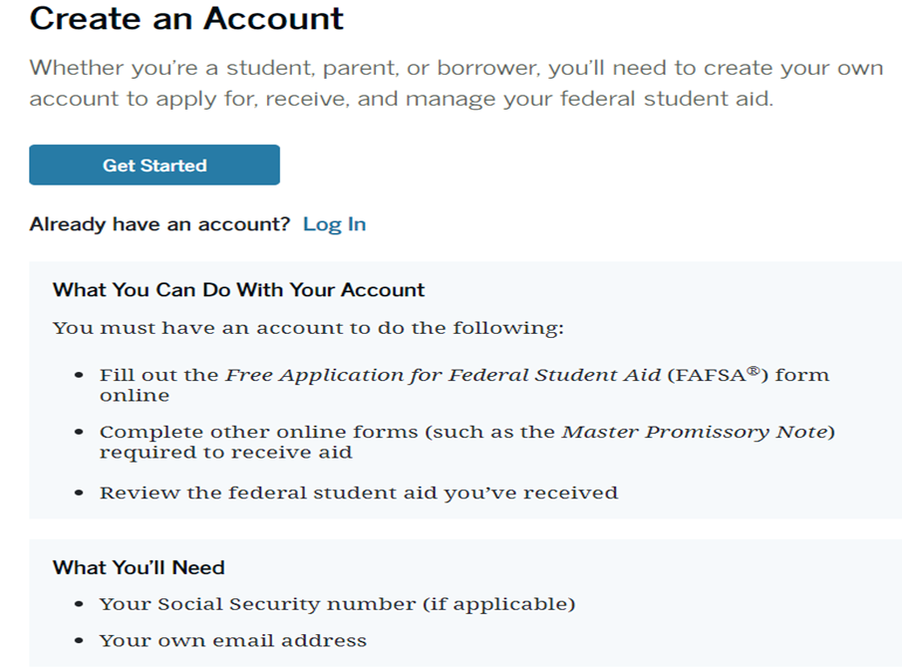
StudentAid.gov Account Needed to File FAFSA (Also Called the FSA ID)
Federal Student Aid Help Line
(800) 4-FED-AID
(800-433-3243)

Slide 33
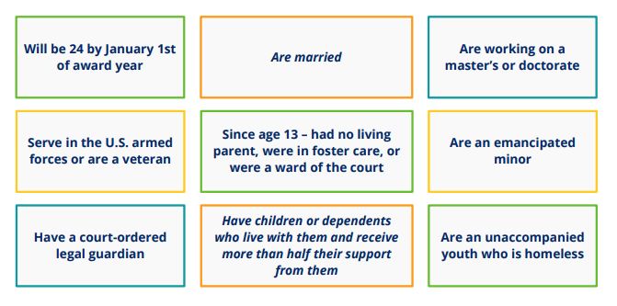
A student is considered to be Independent if any one of these apply:
Otherwise, they are considered to be Dependent

Slide 36
What if Parents Won’t Complete the FAFSA? (cont’d)
If parent information is not provided, the most financial aid that the student can get is unsubsidized Federal Loans unless the college financial aid administrator performs a dependency override
Dependency overrides are rare and generally involve an involuntary dissolution of the family relationship, such as:
Both parents incarcerated or institutionalized
An abusive home environment
Death of the custodial parent
Parental abandonment or estrangement
Parent whereabouts unknown
Contact with parent poses risks

Slide 37
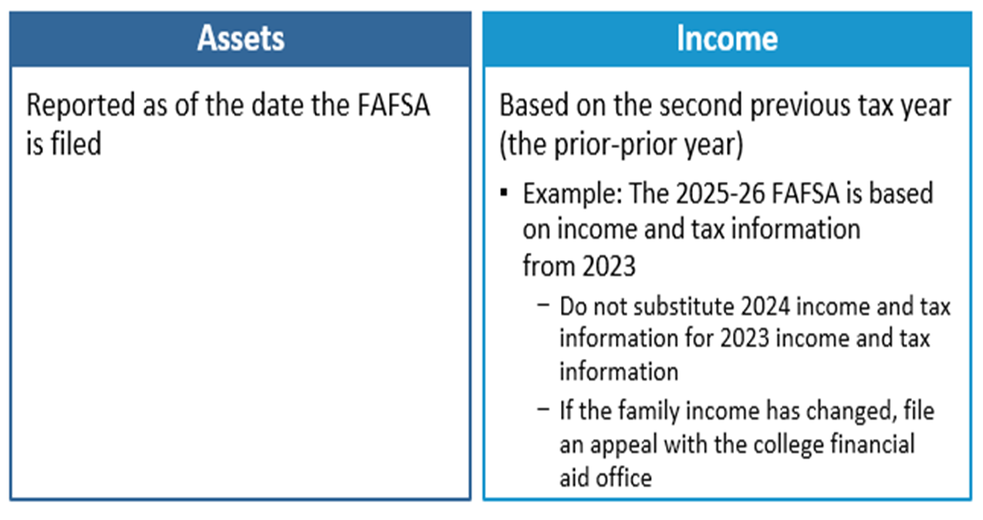
Which year’s information is reported?

Slide 38
Sai calculation - Income (For 2025-2026 School Year use 2023 Tax Return information)
Parent’s
When the student is considered “dependent” for FAFSA purposes
Student’s
$11,510 is “protected” (for the 2025-2026 academic year)
50% of income greater than $11,510 may be added to the SAI
Start with your Adjusted Gross Income (AGI) and include:
IRA Deductions/Payments to self-employed SEP, SIMPLE & Qualified Retirement Plans
Tax Exempt Interest Income
Untaxed Portions of Pensions (excluding rollovers)
Untaxed Portions of IRA Distributions (excluding rollovers)
Foreign Income Exclusion (reported on U.S. Tax Return)

Slide 39
Exempt from asset reporting
Dependent student meets one of these criteria:
The student qualifies for a Maximum Pell Grant
The student’s parents’ 2023 combined AGI is less than $60,000 and
They do not file a Schedule A, B, D, E, F, or H, and
They do not file a Schedule C, or
They file a Schedule C with net business income of not more than a $10,000 loss or gain
Receiving any 1(or more) of 9 federal benefits in 2023 or 2024
9 named programs including:
“Free or reduced-price school lunch”
A universal program in all OR TK-12 public schools
Check the federal income guidelines for FAFSA eligibility (next slide)

Slide 40
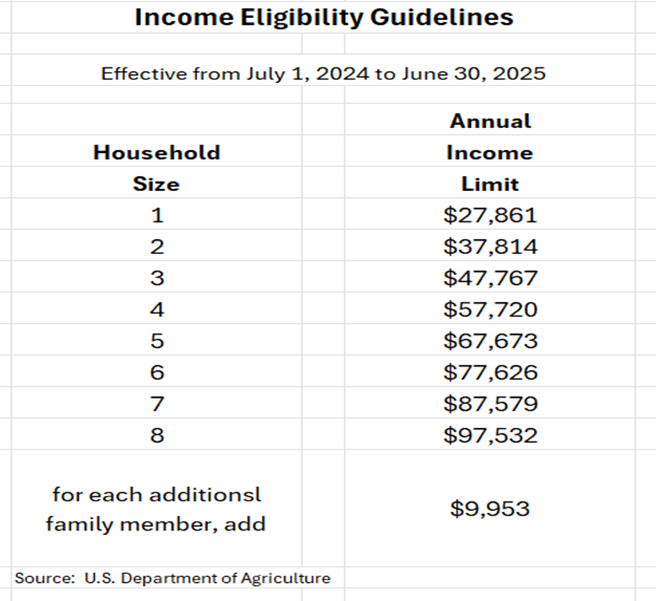
Free or reduced-price school lunch

Slide 41
Fafsa definition of federal benefits received
At any time during 2023 or 2024, did the parent or anyone in their family receive benefits from any of the following federal programs?
EIC can be found on line 27 of your 2023 1040 tax return
Oregon Health Plan OHP is the OR version of Medicaid
QHP credit can be found on line 9 of Schedule 3 or your 2023 or 2024 tax return
Oregon Trail Card is the OR version of SNAP
SSDI is NOT the same benefit as SSI

Slide 42
What Assets to declare for FAFSA
FAFSA Assets Do Not Include:
Home equity (in primary home)
Retirement accounts (IRA, 401k, 403b, Roth, etc.)
Life insurance & annuities
Personal vehicles, boats, firearms, household goods, jewelry, tools etc.
Examples of FAFSA assets to declare:
Cash, Savings, Checking
Net worth of land, investment real estate, etc.
Stocks/Bonds/Trusts/Other Investments (not in retirement accounts)
Net worth of businesses and/or for-profit agricultural operations
College savings plans/529 plans – do not include the value of siblings’ plans (reported as assets of the parents)
Child support received in the last complete calendar year
Note: if net worth is negative, enter zero

Slide 43
sai Calculation – Assets
Parent
When the student is considered “dependent” for FAFSA purposes
Student
20% of student assets may be added into the SAI
Assets are often best kept out of the name of the student
Assets are calculated as of the day the FAFSA is filed

Slide 44
SAI Calculation - Family size
Click YES on Family Size Page to open the option.

Slide 45
Fafsa definition of Family size
How many people are in the parent’s family?
Include
the parent (and spouse or partner)
the student
the parent’s dependent children (even if they live apart because of college enrollment)
and other people living with the parent now
Include these dependent children and other people only if the parent will provide more than half of their support between July 1, 2025, and June 30, 2026

Slide 46
I have filed my fafsa – what happens next?
After the student completes the online FAFSA, a FAFSA Submission Summary (FSS) is sent to the student
An electronic FSS is sent if a student email address is provided
A paper summary is mailed if no student email address is provided
An electronic copy of the FAFSA data is sent to each college or university listed on the FAFSA
Student should keep a copy of the FSS with other financial aid documents

Slide 47
Didn’t GET enough financial aid? Consider these options
Negotiate: Ask the college or university for more financial aid
Scholarships: More detail on future slide
Special Circumstances Consideration: More detail on prior slide
Student job: Work study or on-campus or off-campus
Payment Plans: Your school may have plans to avoid lump sum payments, allowing for several payments throughout a semester
Parent Savings: Food, gas, insurance savings while student is in college
Family resources: Savings, sell assets, 2nd mortgage, credit cards, etc.
Current Income: Allocate more to education expenses
Additional Loans: Government PLUS loans or private loans

Slide 48
What About Scholarships?
Your High School
Counselors know about scholarships given previously to their students
OSAC Scholarship Application
OSAC Scholarship Application Website for Catalog/Application
The Ford Family Foundation – Ford Scholars Program - March 1, 2024
130 Graduating high school students in Southern Oregon or Siskiyou County Ca.
Local Chambers of Commerce, Rotary Clubs, Civic Groups, etc.
National Scholarships (lots out there/lots of competition)
Thousands of scholarships identified by each search engine (3 examples)
Sallie Mae
Fastweb
Big Future
Your College/University Admissions and/or Financial Aid Office

Slide 49
Reducing College Costs
Career Planning before/during college
Changing your major (or college) costs time and money!
Internet research, informational interviews, job shadowing
Avoid dropping classes and focus on graduating on time
Graduate on Time
The longer you are in school, the more it will cost you
Apply for scholarships
Priority on local (smaller applicant pool)
If you are eligible, apply!
Buy used textbooks or rent them
Borrow responsibly
Use College & Career OPTIONS tools
to evaluate and compare award offers
project costs over time
make decisions based on objective factors
Consider an alternative college
Community Colleges can be great options

Slide 50
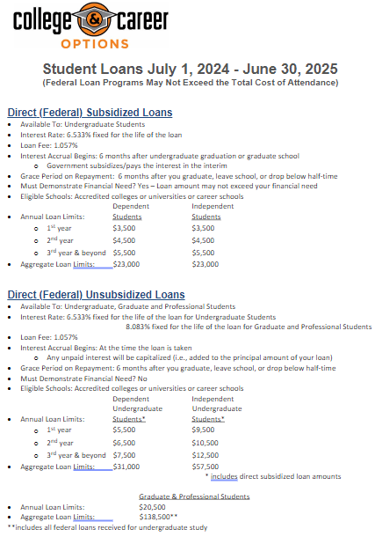

Slide 51
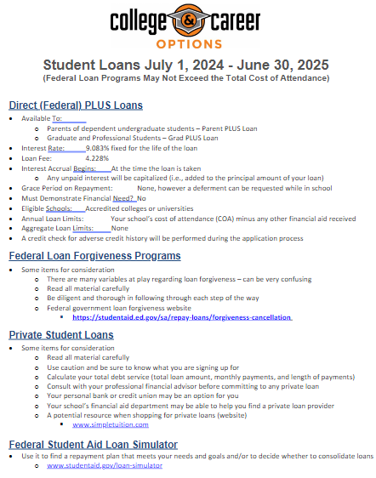

Slide 52
College & Career OPTIONS Financial Aid Tools and Resources

Slide 53
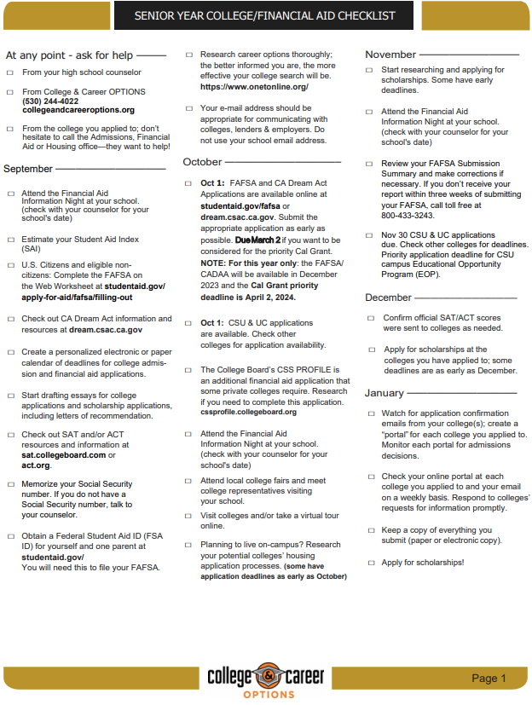

Slide 54
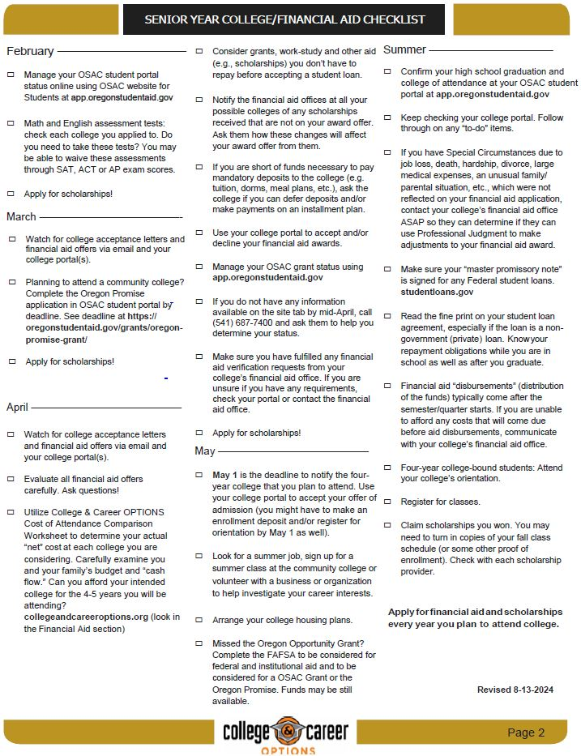

Slide 55
College & career OPTIONS Financial Aid Services
College & Career OPTIONS is a local educational partnership that provides services at no cost to students of all ages who live in Douglas county. Financial Aid services are specifically designed to meet individual needs.
College & Career OPTIONS does not guarantee any specific grants, scholarships, loans or government funding.
Students who receive services, and their parents or other responsible adults, are expected to provide accurate and complete information to advisors for all applications for financial aid. The best options for financial aid are based on up-to-date information.
Our advisors are not financial professionals. We urge students and families to verify information and weigh the options before making financial decisions.
It is our policy to maintain the privacy of every student who accesses services through College & Career OPTIONS. We do not share information with any outside agencies, companies or individuals. With the student’s permission, we may discuss a student’s progress with other educators and/or college admissions and/or financial aid officers for the benefit of the student.
We welcome suggestions, comments and feedback of any kind. The best services are the result of diligent efforts by everyone.
Thank you for allowing us to be of assistance to you.

Slide 56
Some Considerations & Reminders
OOG Grant is good for 4 academic years, including Community College
Use it wisely
Meet all deadlines -OOG Grant has a funding until exhausted starting in spring. File FAFSA early
Oregon Promise only get one shot at applying your senior year or GED completion.
Consider applying to multiple schools to see multiple financial aid offers
After filing the FAFSA/ORSAA, check OSAC Student Portal for progress on Oregon Aid
“Verification” is a financial aid process conducted by your college/university financial aid office
No need to be fearful of this - prove to us that your FAFSA information is true
Keep bank statements from your FAFSA filing date
Department of Education College Scorecard
Compare schools – cost, graduation rate, employment rate, average amount borrowed, loan default rate
www.collegescorecard.ed.gov
Reach out to College & Career OPTIONS if you need assistance
www.collegeandcareeroptions.org
530-244-4022
Follow College & Career OPTIONS on social media @collegeandcareeroptions

Slide 57
WITH GRATITUDE!!!
A huge thank you to our
College & Career OPTIONS funders!!!
Because of their generosity, all services provided by College & Career OPTIONS personnel are free to Douglas County families

Slide 58
Thank you!!!
We are always trying to improve our effectiveness.
If you have suggestions for improvement, please see me or call me or email me
Robert Adams
Director of College and Career Services
College & Career OPTIONS
Email: radams@collegeandcareeroptions.org
Phone: 530-768-5107
Thank you for attending this presentation and for your interest in financial aid

