Slide 1



Financial Aid 2026-2027
Robert Adams - radams@collegeandcareeroptions.org
530-244-4022 530-768-5107
@collegeandcareeroptions on social media
WWW.COLLEGEANDCAREEROPTIONS.ORG

Slide 2



Providing college and career preparation services
Serving students and families since 2003
A non-profit organization securing grant funding to be able to provide free services and resources to your county.
  Southern Oregon; Douglas - Klamath
Three primary service lines
  Academic/College Preparation
  Career Exploration
  Financial Aid
Appointments available 530-244-4022

Slide 3

Goals for Today
Take the mystery out of the financial aid process and provide a basic understanding of how financial aid works
Provide an understanding of how to maximize your financial aid potential
Help you understand the amount of federal and CA financial aid that you are eligible for

Slide 4
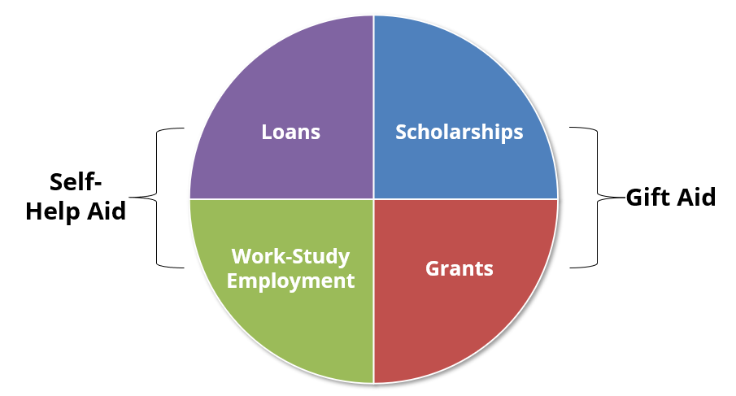
Types of Financial Aid

Slide 5
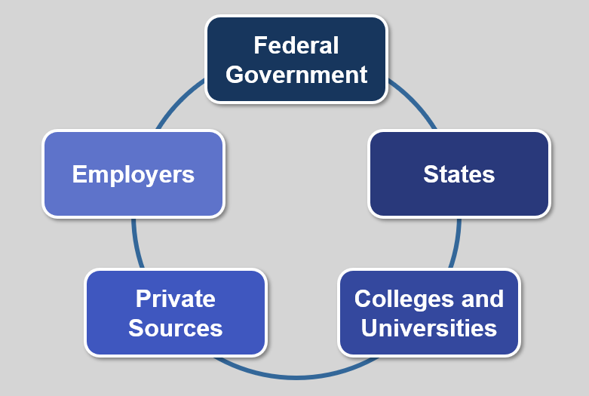
Sources of Financial Aid

Slide 6
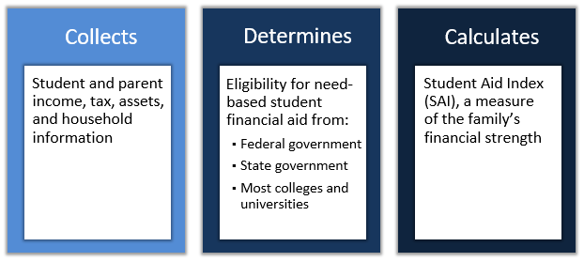
What is the Free Application for Federal Student Aid?
Gateway to need-based student financial aid from:
  Federal Government
  State Government
  Colleges & Universities

Slide 7
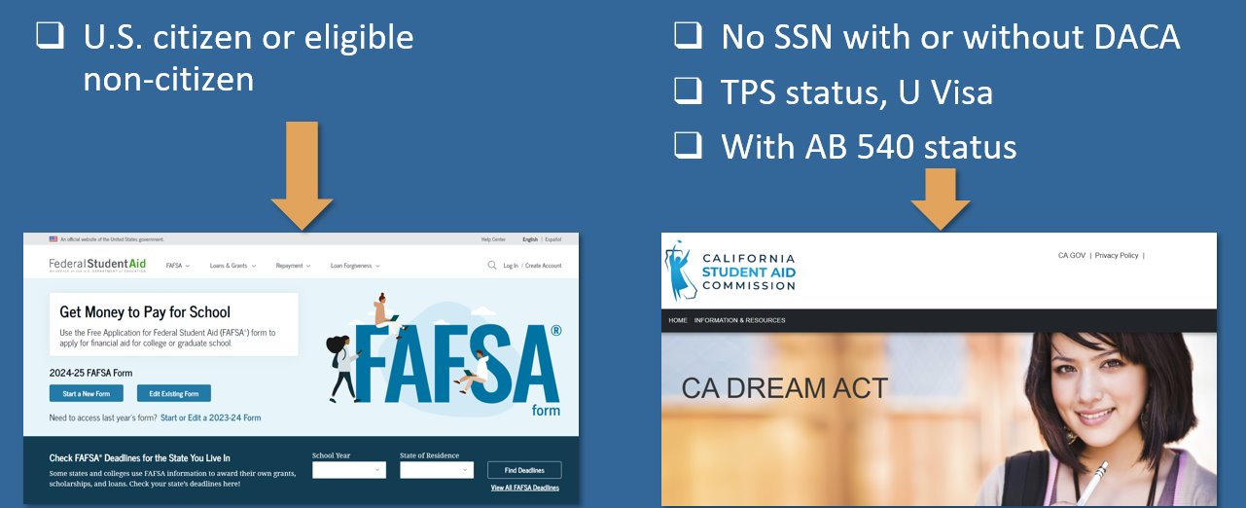
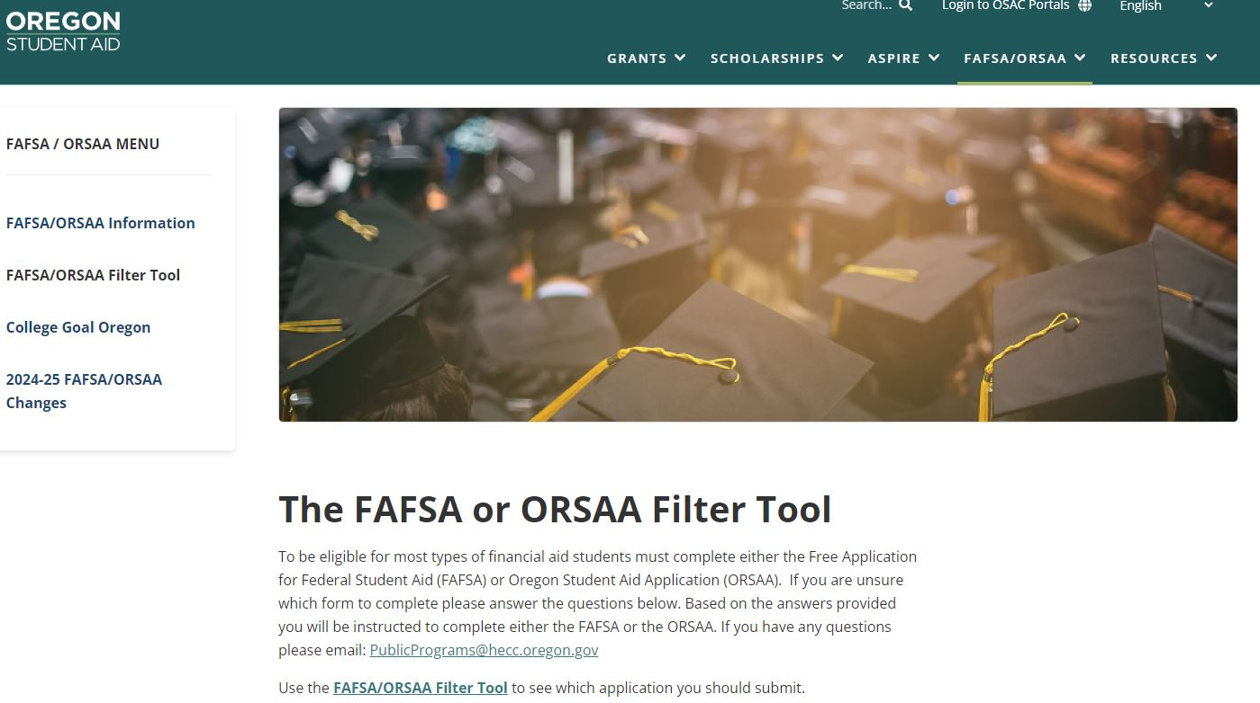
Which Financial Aid Application to Submit?

Slide 8

Compelling reasons to File A FAFSA
Even if you don’t think you will qualify for need based aid, consider the following:
Regardless of income level, a FAFSA must be filed to receive free CA Community College tuition
Allows for access to government student loans
Allows for the opportunity to secure need-based aid if life circumstances and/or financial circumstances change (special circumstances)
You can qualify for the CA Middle Class Scholarship even if you earned up to $250,000 of income and have up to $250,000 of assets
Some schools will not consider you for merit scholarships until you have submitted a FAFSA
FAFSA completion required for CA high school seniors unless opt-out

Slide 9


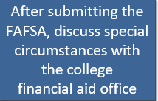
Special Circumstances – appeal for more financial aid
Family’s financial circumstances have changed (even mid-year) or differ from the typical family
  Changes to family income or assets
  Recent unemployment
  High dependent care expenses
  Housing change due to homelessness
  High unreimbursed medical or dental expenses
  One-time events (e.g., a bonus) that do not reflect ability to pay

Slide 10
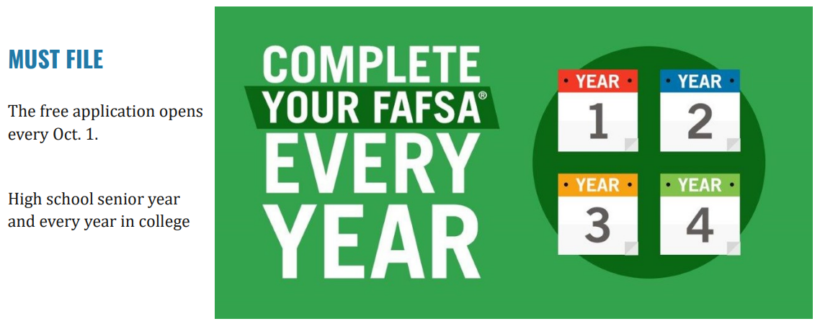

WHEN TO FILE THE FAFSA OR CADAA?

Slide 11
WHEN TO FILE THE FAFSA? (continued)
File as soon as possible to qualify for more grants/scholarships from schools.
  You can even file the FAFSA/ORSAA before submitting college admissions applications
Funds are limited
Oregon Opportunity Grant - Awards given to students with the greatest financial need, based on their SAI. Awards start in spring until funds are exhausted for the year.
SUBMIT FAFSA or ORSAA as soon as possible after October 1 each year.
Oregon Promise Grant
Complete all of the steps by your application deadline (varies by graduation date). For most students, you MUST apply during your senior year of high school (before you graduate), or immediately after GED® test completion.

Slide 12
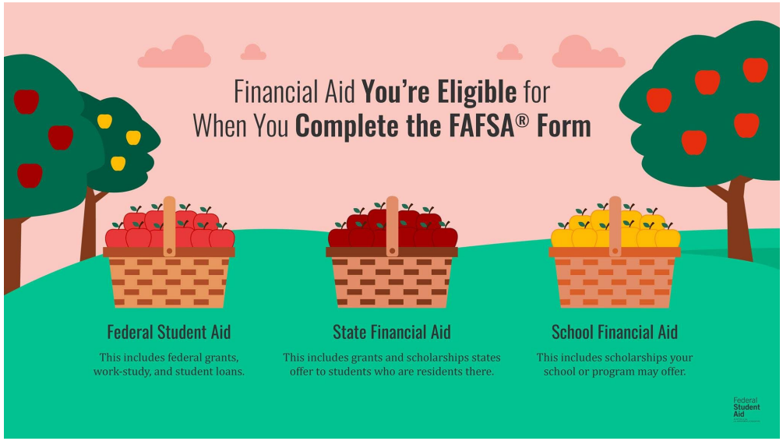
Multiple Agencies Get FAFSA Data Simultaneously

Slide 13

Cost of
Attendance
Cost of Attendance
(COA)
“Sticker Price” to attend a college
  Average college costs including tuition, fees, books, misc. and living expenses
  It is NOT your bill
Costs can vary from school-to-school
Used to determine a student’s financial need calculation
Notes:
Notes:
Cost of Attendance is not what students and families should expect to pay, think of it like a “estimated sticker price” for college or an average price to attend a particular college. The actual cost to attend college will depend on different circumstances like financial aid and living situations.
The Cost of Attendance will differ from school to school because the cost to got to PCC is different then the cost to attend Lewis and Clark or PSU.
COA is used to determine a student’s financial need calculation.
A Cost of Attendance (COA) document for the school year is available on HECC website which includes Oregon community colleges, Oregon public universities, and most Oregon-based private non-profit colleges. You can also find a COA list in the ECMC booklets or on institutions websites or via catalogs.

Slide 14
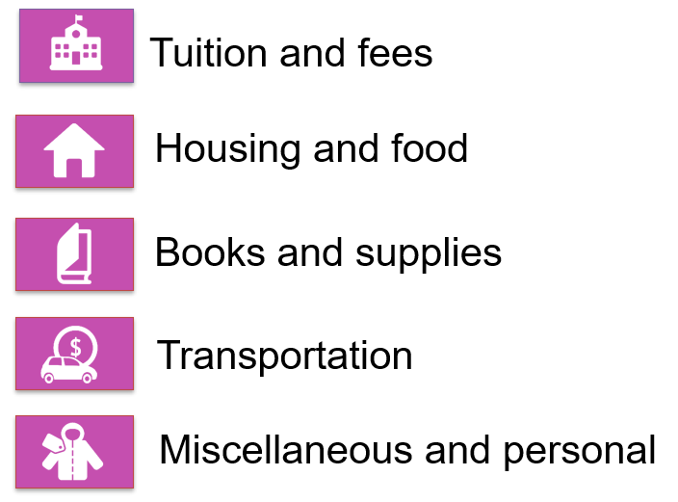
what is cost of attendance? (coa)

Slide 15
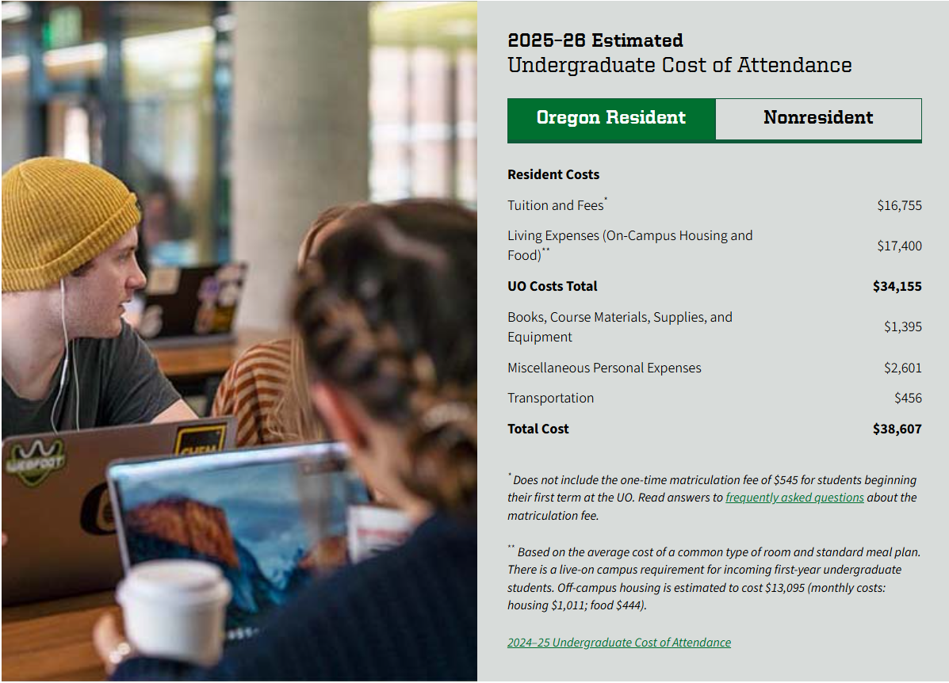
University of Oregon Cost of Attendance 2024-2025 (ESTIMATED)
Notes:
Can look this up on any university or college site

Slide 16

(ESTIMATED) Cost Of Attendance
Comparison 2025-2026***
UMPQUA Community College (OR Community College)
  $20,633* Tuition & Fees - $6,105 Books – $1,599
Oregon State University (OR Public 4-year)
  $36,747** Tuition & Fees - $15,246 Books – $600
University of Oregon (OR Public 4-year)
  $38,607 ** Tuition & Fees - $16,755 Books - $1,395
Willamette University (Private)
  $71,254 ** Tuition & Fees - $25,578 Books - $1,252
*Living at Home
**Living on Campus
*** As Displayed on Website
Douglas
Notes:
Don’t give up on private schools

Slide 17
(ESTIMATED) Cost Of Attendance
Comparison 2025-2026***
Klamath Community College (OR Community College)
  $12,059* Tuition & Fees - $6,300 Books – $1,500
Oregon Institute of Technology (OR Public 4-year)
  $23,625* Tuition & Fees - $12,529 Books – $1,000
University of Oregon (OR Public 4-year)
  $38,607 ** Tuition & Fees - $16,755 Books - $1,395
Willamette University (Private)
  $71,254 ** Tuition & Fees - $25,578 Books - $1,252
*Living at Home
**Living on Campus
*** As Displayed on Website
Klamath
Notes:
Don’t give up on private schools

Slide 18
(ESTIMATED) Cost Of Attendance
Comparison 2025-2026***
Southwestern Oregon Community College (OR Community College)
  $20,160* Tuition & Fees - $7,725 Books - $1,500
Southern Oregon University (OR Public 4-year)
  $23,625* Tuition & Fees - $13,308 Books - $999
University of Oregon (OR Public 4-year)
  $38,607 ** Tuition & Fees - $16,755 Books - $1,395
Willamette University (Private)
  $71,254 ** Tuition & Fees - $25,578 Books - $1,252
*Living at Home
**Living on Campus
*** As Displayed on Website
Coos & Curry
Notes:
Don’t give up on private schools

Slide 19
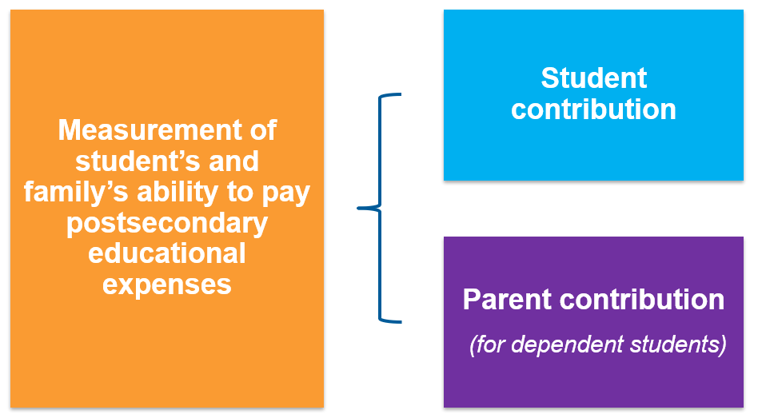
what is the student aid index? (sai)

Slide 20

Financial Aid OFFErs
Applied to the school
+ accepted to the school
+ listed the school on your FAFSA (can list up to 20)
= You will get a Financial Aid Offer from the school
Example:
  COA $29,000 (School Cost of Attendance)
  -SAI - $ 4,000 (Your Student Aid Index)
Financial Need $25,000
Schools offer varying amounts of financial aid, some more generous than others
Applying to multiple schools gives you more financial aid offers to consider

Slide 21
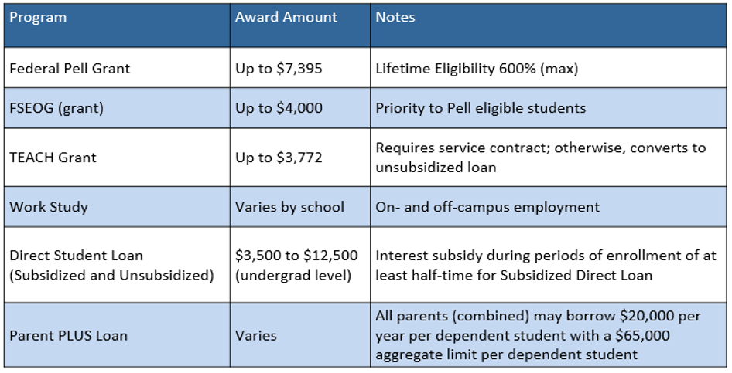
Financial AiD opportunities
Federal Aid Programs - 2025-2026 Information

Slide 22
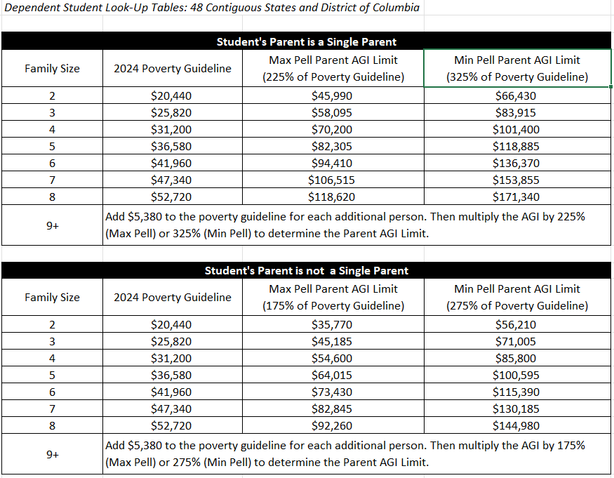
Financial AiD opportunities
Federal Pell Grant Program Aid Program - 2026-2027 Information

Slide 23

Financial AiD opportunities
Federal Aid Programs - 2025-2026 Information
  How is a Pell Grant Award determined?
    An automatic Maximum Pell Grant Award of $7,395 per year – Max Pell
    (see eligibility chart)
    SAI-calculated Pell Grant
      Maximum Pell Grant (i.e., $7,395) – SAI = Pell Award
    A Minimum Pell Grant Award of $740 – Min Pell (i.e., 10% of Max Pell)
    (see eligibility chart) – Min Pell
      Students prevented from getting a Pell Grant if SAI exceeds 14,790
  Federal Student Aid Estimator
    studentaid.gov/aid-estimator
      Calculates Student Aid Index (SAI) and gives federal financial aid estimate (Pell Grant)

Slide 24

Financial AiD opportunities
California Aid Programs* - 2025-2026 Information
  Cal Grant $1,648 - $16,582/year (4 years max)
  California College Promise Program
    First 2 years of community college tuition-free for lower income students who file a FAFSA/CADAA
  Shasta Promise – Shasta College
    Full-time student + file a FAFSA/CADAA = free tuition (regardless of income)
  California Middle Class Scholarship (MCS) - Up to $250,000 income and $250,000 assets
  *Applies to all accredited and approved schools in California

Slide 25

Oregon Opportunity Grant
Awards given to students with the greatest financial need, based on their SAI. Awards start in spring until funds are exhausted for the year.
SUBMIT FAFSA or ORSAA as soon as possible after October 1 each year.
Students enrolled full-time for a full-year in 2026-27:
Community College
$1,182 - $4,272
BAS Program at Community College
$1,452 - $5,964
4-Year College or University
$1,740 - $7,800
Submit the 2026-27 FAFSA or ORSAA as soon as possible to apply for 2026-27 Oregon Opportunity Grant. Awarding for 2026-27 will continue until funds are depleted.
Notes:
What percentage of those that qualify get funded. Maybe they never run out of money. Find out if they actually run out and when.

Slide 26
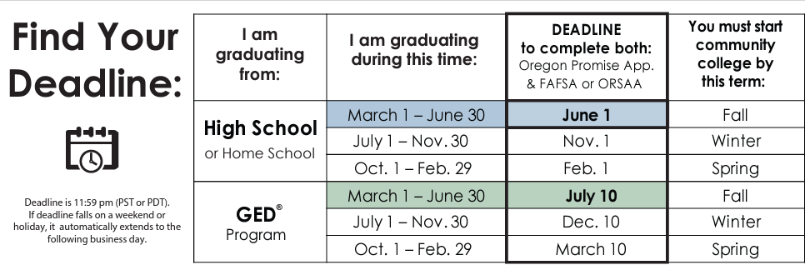
Oregon Promise Grant
Complete all of the steps by your application deadline (varies by graduation date). For most students, you MUST apply during your senior year of high school (before you graduate), or immediately after GED® test completion
How to Apply:
Submit the Oregon Promise application in the OSAC Student Portal.
Submit the FAFSA or ORSAA for the year that you will start college.
  List at least one Oregon community college on the FAFSA or ORSAA.
Awarding Information for Class of 2026
Oregon Promise Grant awarding will begin in Spring 2026 to new students (Class of 2026) who will begin college in Fall 2026. APPLY SPRING OF 2026. Must attend within 6 months of HS/GED graduation.
2025: At this time, the Final SAI limit of 18,000 for new students. Regardless of income, all students must apply by their deadline in order to be considered for the grant. Most students must apply by June 1. All students only have one opportunity to apply for Oregon Promise, based on their graduation date.

Slide 27
Oregon tribal student grant
  Student Eligibility
    Enrolled member of one of the nine federally recognized tribes in Oregon
    Enrolled at least half time in eligible Oregon college or university.
    Complete Oregon Tribal Student Grant application in the OSAC Student Portal.
    Submit FAFSA Or ORSAA
    Working towards first degree or credential at current level.
  The final deadline to apply for the 2026-27 academic year is April 3, 2026.
  Award determination is based on other awards (Pell, OOG, OPG) as well as Cost of Attendance (COA)
  This is a last dollar award, so all other grants, scholarships, fee waivers will be applied first

Slide 28
Financial AiD opportunities
Institutional Aid
  Scholarships & Grants
    Need-based (financial need) and/or
    Merit-based (student talent or skill)
    Scholarships & Grants vary by school
      Apply to several schools to see several financial aid offers
Out of State Schools
  Western Undergraduate Exchange (WUE)
    Enables students in 16 western states & territories to enroll at 160+ participating public schools outside their home state and pay reduced tuition.
      WUE rate of 150% in-state tuition (or less)

Slide 29
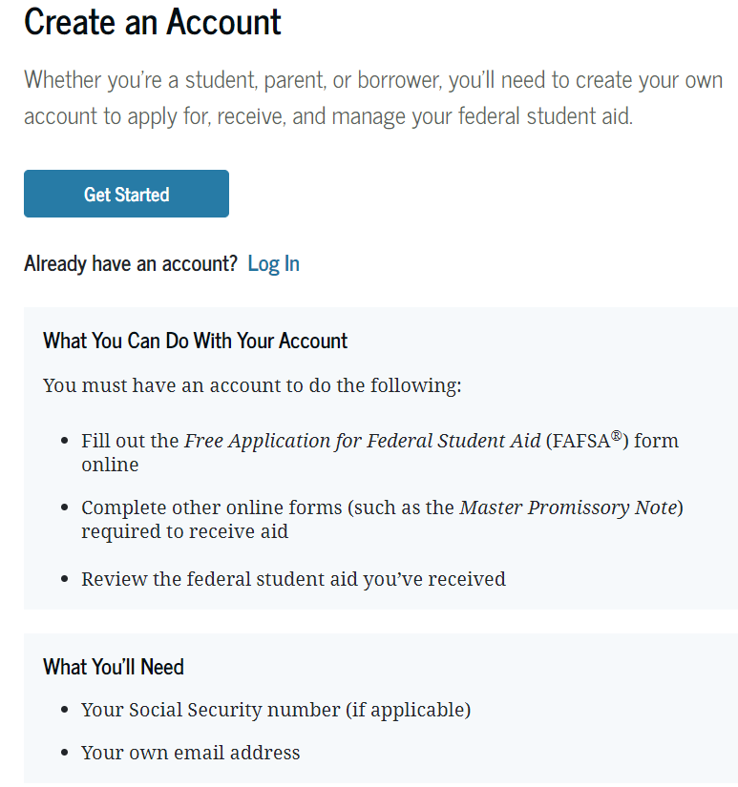

StudentAid.gov Account Needed to File FAFSA (Also Called the FSA ID)
  Federal Student Aid Information Center (FSAIC) (Help Line)
(800) 4-FED-AID
(800-433-3243)
Live Chat
Email

Slide 30

The OSAC
Create a Student Account
Student Portal
Applications and Awards:
  Oregon Promise Grant
  Chafee Education Grant
  Child Care Grant
  Oregon Tribal Student Grant
  OR National Guard State Tuition Assistance
  OSAC Scholarships
OregonStudentAid.Gov
Notes:
Notes-
The OSAC portal is where students can apply for a variety of grants and scholarships administered by the State of Oregon. OSAC recommends students create a portal account as soon as possible so that they are ready for the scholarship/grant application process.
Students are encouraged to check their email and portal account regularly during the spring to check for any award notifications. Can apply as soon as Freshman year but this isn’t the application for the grants. Need to get back in and see what they can apply for. Then they apply every year.

Slide 31
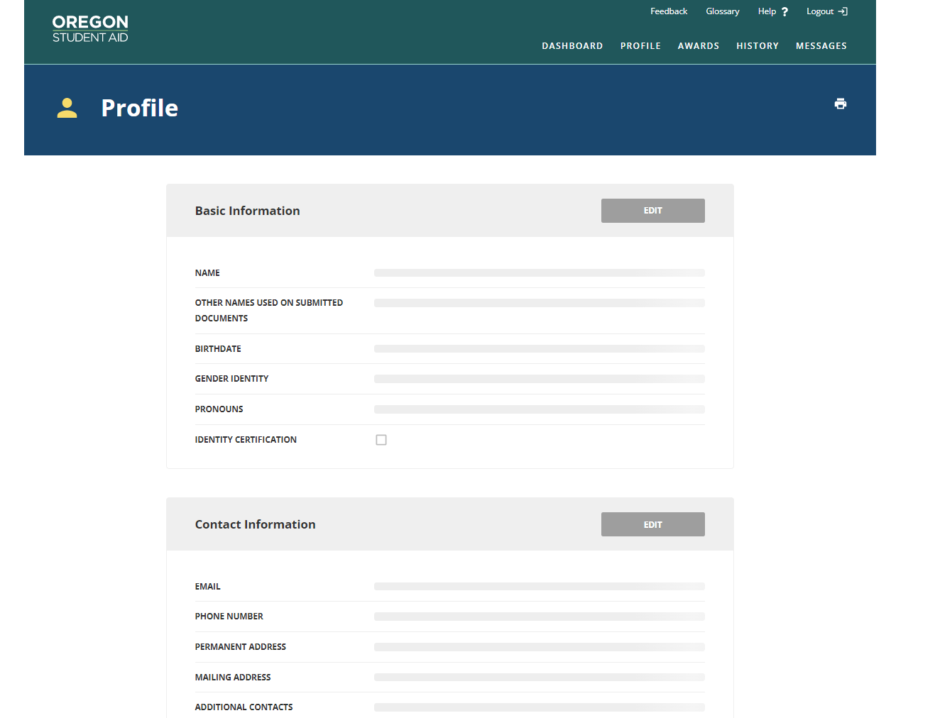
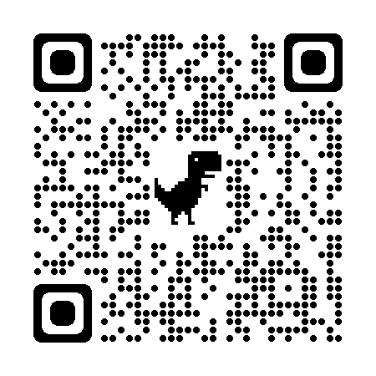
creating an
OSAC Portal Account
Use your legal name, make sure it is the same name as the one on your FAFSA/ORSAA
Password must be 12 characters including digits, upper case letter, lower case letter, and symbol (e.g. @$%)
https://app.oregonstudentaid.gov/
Notes:
Notes-
Creating an OSAC portal account is easy, but a few things can be tricky.
Make sure to use your legal name and the name that matches your FAFSA or ORSAA application
Remember your password is 12 characters and has specific requirements
Students should sign up with a personal email account, not a high school or college-operated email account, so that they will have access to their portal account indefinitely. Students are encouraged to check their email and portal account regularly during the spring to check for any award notifications.
Remember to stay organized, it is hard to reset a username and password so make sure to keep track of your username and password

Slide 32
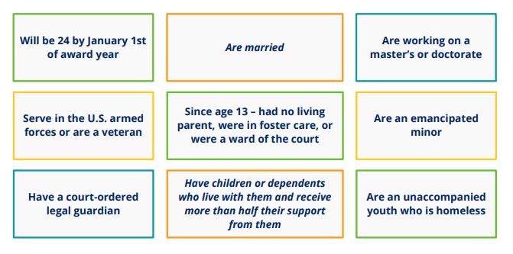
A student is considered to be Independent if any one of these apply:
Otherwise, they are considered to be Dependent

Slide 33
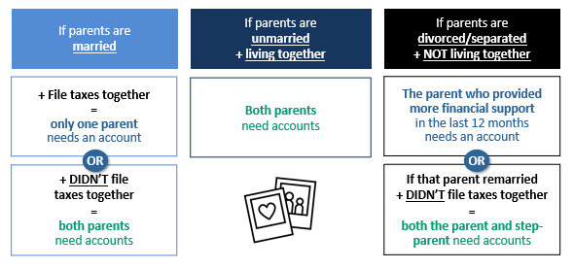
Which of a Dependent Student’s Parents Need an FSA ID?

Slide 34
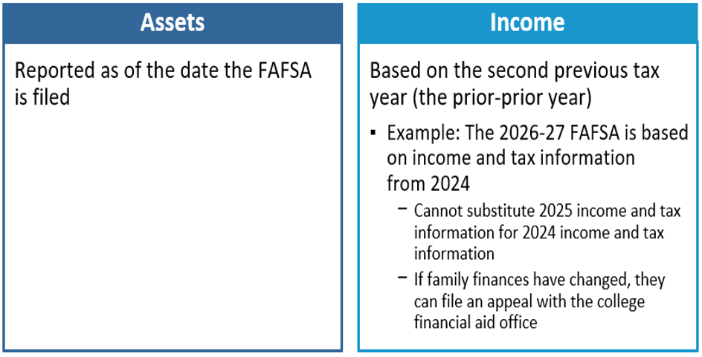
Which year’s information is reported?

Slide 35

Sai calculation - Income
(For 2026-2027 School Year use 2024 Tax Return information)
Parent’s
  When the student is considered “dependent” for FAFSA purposes
Student’s
  $11,770 is “protected” (i.e., 2024 income for the 2026-2027 academic year)
  50% of income greater than $11,770 may be added to the SAI
Start with your Adjusted Gross Income (AGI) and include:
  IRA deductions & payments to self-employed SEP, SIMPLE, Keough, and other qualified retirement accounts
  Foreign earned income if exempt from taxation
  Tax Exempt Interest Income
  Untaxed Portions of Pensions (excluding rollovers)
  Untaxed Portions of IRA Distributions (excluding rollovers)

Slide 36

Exempt from asset reporting
Dependent student meets one of these criteria:
  The student qualifies for a Maximum Pell Grant
  The student’s parents’ 2024 combined AGI is less than $60,000 and
    They do not file a Schedule A, B, D, E, F, or H, and
    They do not file a Schedule C, or
      They file a Schedule C with net business income of not more than a $10,000 loss or gain
  Receiving any 1(or more) of 9 federal benefits in 2024 or 2025
    9 named programs including:
      “Free or reduced-price school lunch”
        A universal program in all CA TK-12 public schools
          Check the income guidelines for FAFSA eligibility (next slide)

Slide 37
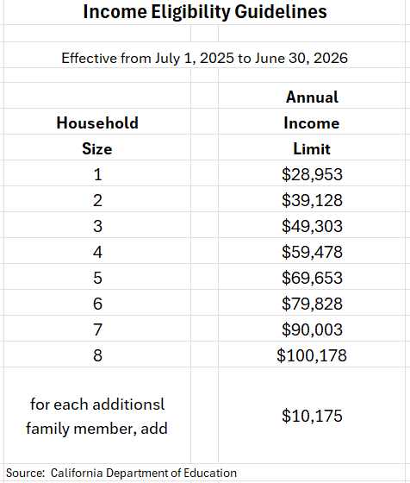
Free OR reduced-price school lunch

Slide 38
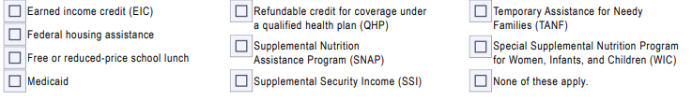

Fafsa definition of federal benefits received
At any time during 2024 or 2025, did the parent or anyone in their family receive benefits from any of the following federal programs?
EIC can be found on line 27 of your 2024 or 2025 1040 tax return
Oregon Health Plan OHP is the OR version of Medicaid
QHP credit can be found on line 9 of Schedule 3 of your 2024 or 2025 tax return
Oregon Trail Card is the OR version of SNAP
SSDI is not the same benefit as SSI
Notes:
Is Line 27 for EIC anything but zero then you can check it.

Slide 39

What Assets to declare for FAFSA
FAFSA Assets Do Not Include:
Home equity (in primary home)
Retirement accounts (IRA, 401k, 403b, Roth, etc.)
Life insurance & annuities
Family business with less than 100 FT employees
Farms where the family resides
Commercial fishing business owned/controlled by a family
Personal vehicles, boats, firearms, household goods, jewelry, tools etc.
Examples of FAFSA assets to declare:
Cash, Savings, Checking
Net worth of land, investment real estate, etc.
Stocks/Bonds/Trusts/Other Investments (not in retirement accounts)
College savings plans/529 plans – do not include the value of siblings’ plans (report as an asset of the parents)
Annual child support received in most recent completed calendar year
Note: if net worth is negative, enter zero

Slide 40

sai Calculation – Assets
Parent
  When the student is considered “dependent” for FAFSA purposes
Student
  20% of student assets may be added into the SAI
    Assets are often best kept out of the name of the student
  Assets are calculated as of the day the FAFSA is filed

Slide 41

Fafsa definition of Family size
How many people are in the parent’s family?
  Include
    the parent (and spouse or partner)
    the student
    the parent’s dependent children (even if they live apart because of college enrollment)
    and other people living with the parent now
Include these dependent children and other people only if the parent will provide more than half of their support between July 1, 2026, and June 30, 2027
FAFSA family size does not need to match the family size indicated on your tax return

Slide 42
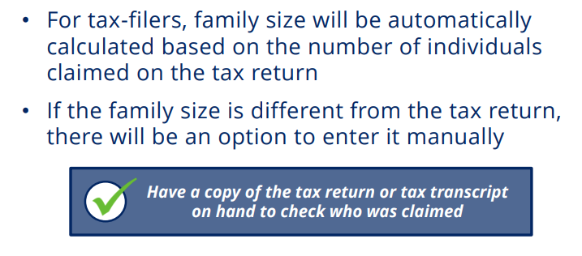
SAI Calculation - Family size

Slide 43

I have filed my fafsa – what happens next?
After the student completes the online FAFSA, a FAFSA Submission Summary (FSS) is sent to the student
  An electronic FSS is sent if a student email address is provided
  A paper summary is mailed if no student email address is provided
An electronic copy of the FAFSA data is sent to each college or university listed on the FAFSA
Student should keep a copy of the FSS with other financial aid documents

Slide 44

Didn’t GET enough financial aid? Consider these options
  Negotiate: Ask the college or university for more financial aid
  Scholarships: More detail on future slide
  Special Circumstances Consideration: More detail on prior slide
  Student job: Work study or on-campus or off-campus
  Payment Plans: Your school may have plans to avoid lump sum payments, allowing for several payments throughout a semester
  Parent Savings: Food, gas, insurance savings while student is in college
  Family resources: Savings, sell assets, 2nd mortgage, credit cards, etc.
  Current Income: Allocate more to education expenses
  Additional Loans: Government PLUS loans or private loans

Slide 45

Reducing College Costs
Career Planning before/during college
  Changing your major (or college) costs time and money!
  Internet research, informational interviews, job shadowing
  Avoid dropping classes and focus on graduating on time
Graduate on Time
  The longer you are in school, the more it will cost you
Apply for scholarships
  Priority on local (smaller applicant pool)
  If you are eligible, apply!
Buy used textbooks or rent them
Borrow responsibly
Use College & Career OPTIONS tools
  to evaluate and compare award offers
  project costs over time
  make decisions based on objective factors
Consider an alternative college
  Community Colleges can be great options

Slide 46

What About Scholarships?
Your High School
  Counselors know about scholarships given previously to their students
OSAC Scholarship Application
  OSAC Scholarship Application Website for Catalog/Application
The Ford Family Foundation – Ford Scholars Program - March 2, 2026
  130 Graduating high school students in Southern Oregon or Siskiyou County Ca.
Local Chambers of Commerce, Rotary Clubs, Civic Groups, etc.
National Scholarships (lots out there/lots of competition)
  Thousands of scholarships identified by each search engine (3 examples)
    Scholarships360
    Sallie Mae
    Fastweb
    Big Future
Your College/University Admissions and/or Financial Aid Office

Slide 47
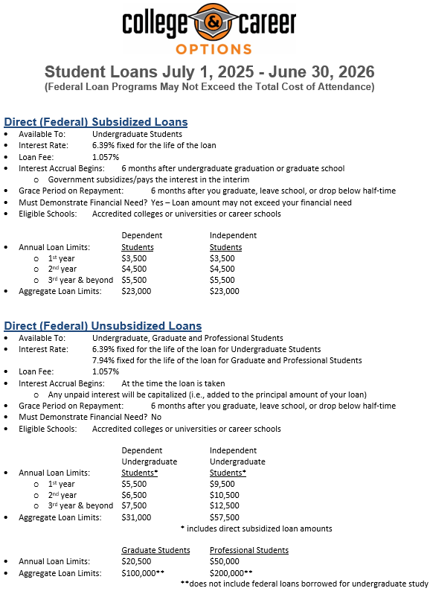


Slide 48
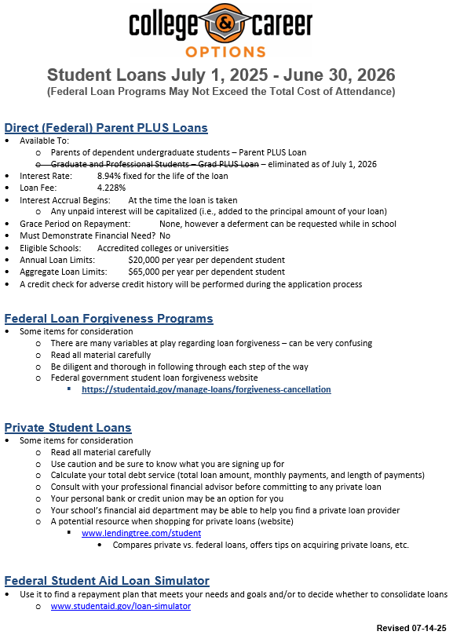


Slide 49

College & Career OPTIONS Financial Aid Tools and Resources

Slide 50
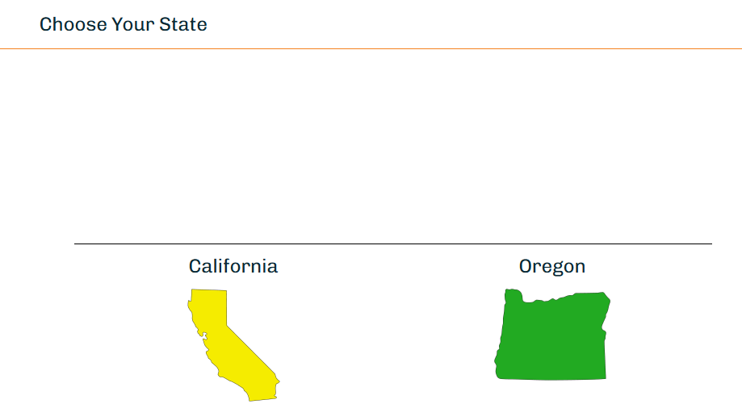
College & Career OPTIONS Financial Aid Tools and Resources

Slide 51
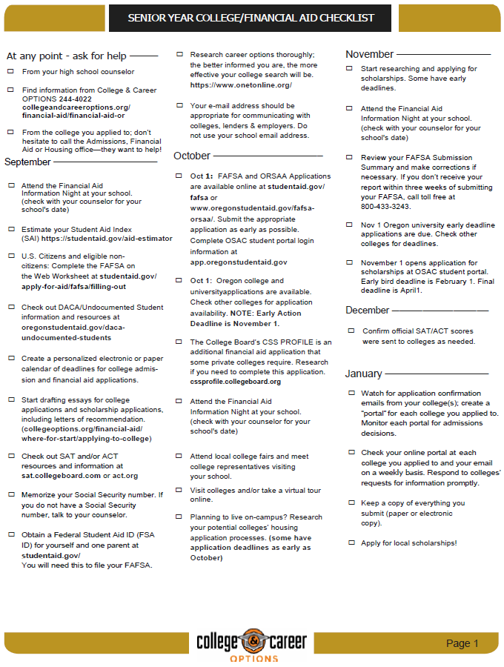



Slide 52
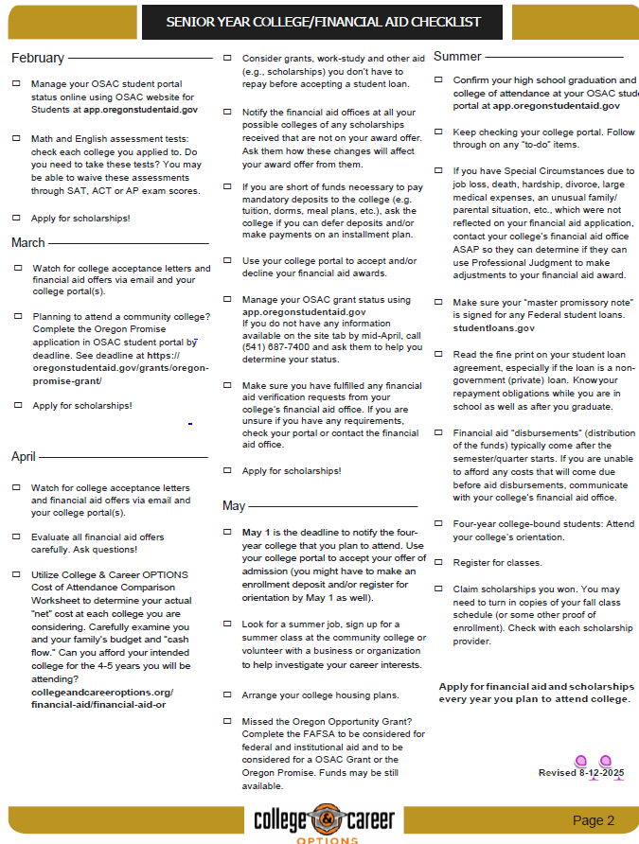


Slide 53

College & career OPTIONS Financial Aid Services
College & Career OPTIONS is a local educational partnership that provides services at no cost to students of all ages who live in Douglas county. Financial Aid services are specifically designed to meet individual needs.
College & Career OPTIONS does not guarantee any specific grants, scholarships, loans or government funding.
Students who receive services, and their parents or other responsible adults, are expected to provide accurate and complete information to advisors for all applications for financial aid. The best options for financial aid are based on up-to-date information.
Our advisors are not financial professionals. We urge students and families to verify information and weigh the options before making financial decisions.
It is our policy to maintain the privacy of every student who accesses services through College & Career OPTIONS. We do not share information with any outside agencies, companies or individuals. With the student’s permission, we may discuss a student’s progress with other educators and/or college admissions and/or financial aid officers for the benefit of the student.
We welcome suggestions, comments and feedback of any kind. The best services are the result of diligent efforts by everyone.
Thank you for allowing us to be of assistance to you.

Slide 54

Some Considerations & Reminders
OOG Grant is good for 4 academic years, including Community College
  Use it wisely
Meet all deadlines -OOG Grant has a funding until exhausted starting in spring. File FAFSA early
Oregon Promise only get one shot at applying your senior year or GED completion.
Consider applying to multiple schools to see multiple financial aid offers
After filing the FAFSA/ORSAA, check OSAC Student Portal for progress on Oregon Aid
“Verification” is a financial aid process conducted by your college/university financial aid office
  No need to be fearful of this - prove to us that your FAFSA information is true
    Keep bank statements from your FAFSA filing date
Department of Education College Scorecard
  Compare schools – cost, graduation rate, employment rate, average amount borrowed, loan default rate
  www.collegescorecard.ed.gov
Reach out to College & Career OPTIONS if you need assistance
  www.collegeandcareeroptions.org
  530-244-4022
Follow College & Career OPTIONS on social media @collegeandcareeroptions

Slide 55
WITH GRATITUDE!!!
A huge thank you to our
College & Career OPTIONS funders!!!
Because of their generosity, all services provided by College & Career OPTIONS personnel are free to Douglas County families

Slide 56



Thank you!!!
We are always trying to improve our effectiveness.
  If you have suggestions for improvement, please see me or call me or email me
  Robert Adams
  Director of College and Career Services
  College & Career OPTIONS
  Email: radams@collegeandcareeroptions.org
  Phone: 530-768-5107
Thank you for attending this presentation and for your interest in financial aid

